Slide 1
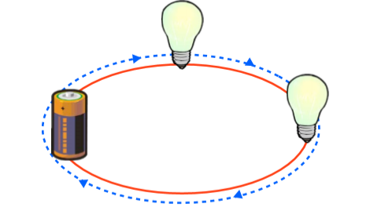
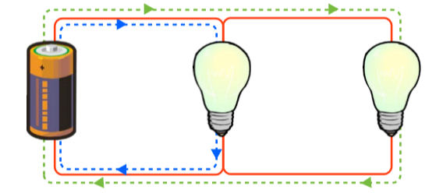
Year 6 Knowledge Mat: Electricity
Subject Specific Vocabulary: Electricity
Volt | A volt is a unit of measurement that shows the rate at which energy is drawn from a source that produces the flow of electricity.
Circuit | A closed path along which electrical current can flow.
Current | The flow of electrical charge around a circuit. Current is usually measured in amperes.
Insulator | A material that does not allow electricity to flow through it.
Conductor | A material that allows electricity to flow through it.
Component | A component is a part of the whole electrical circuit. Wires, bulbs, motors and batteries are all components.
Battery | A container containing cells in which chemical energy is converted into electricity and used as a power source.
Motor | A machine charged by electricity that causes movement.
Subject Specific Vocabulary: Electricity
Series Circuit | Has just one path for electricity to flow around. They are generally only used when there is one component, such as one light bulb or one buzzer.
Parallel Circuit | Provides more than one path for electricity to flow around. If one of the bulbs in the circuit were to blow, the other would still work because there is another complete circuit for the electricity to flow around.

