Slide 1
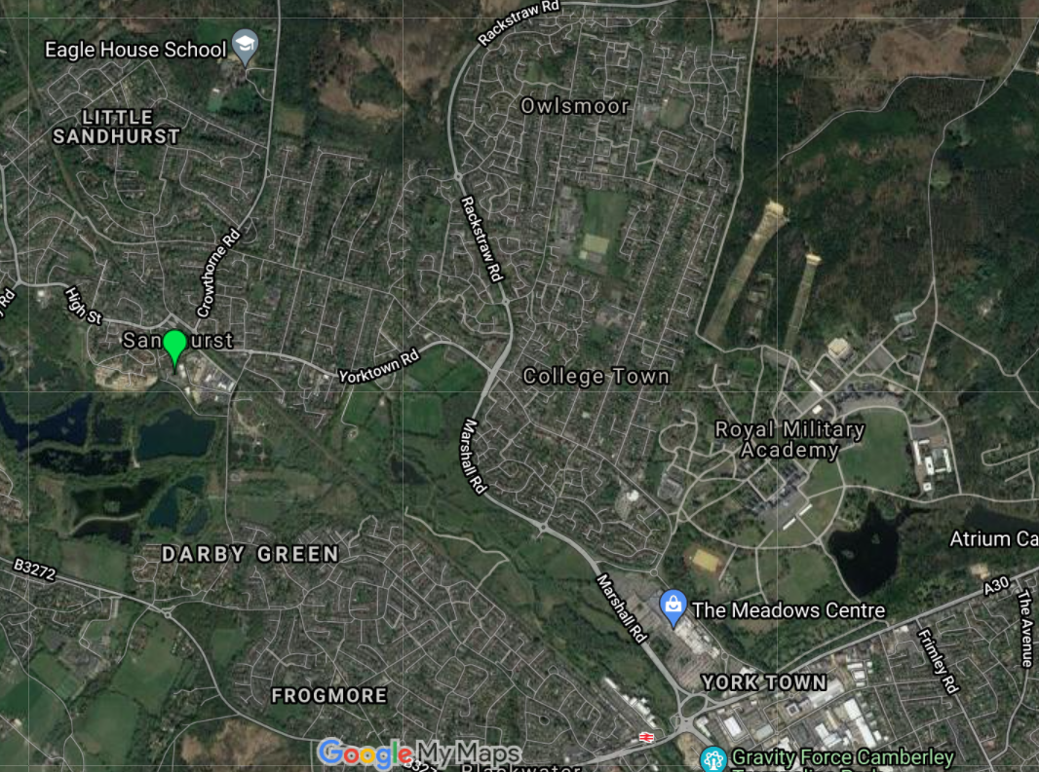
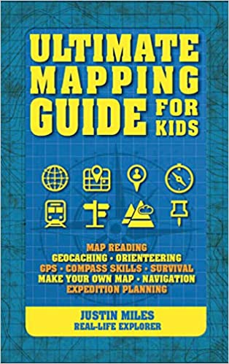
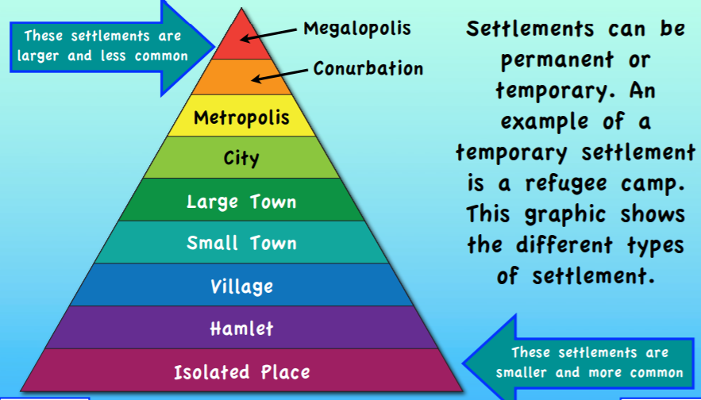
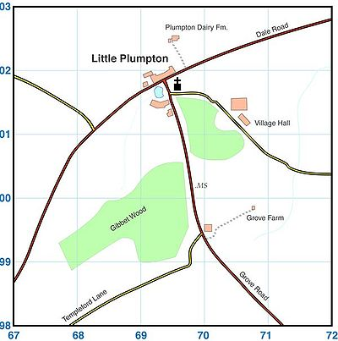
Year 6 Knowledge Mat: Our Local Area
Subject Specific Vocabulary
Equator | An imaginary line around the middle of the globe which separates the north and the south.
Map | A diagram representing a portion of land or sea which shows the geographical and man-made features of the area.
Atlas | A book of maps and geographical information.
Globe | A 3D model of the Earth.
Compass Points | 8 points which show in which direction you are travelling around the globe.
Grid Reference | A way of locating a specific point on a map using a number grid which goes across and up
Physical Features | Physical geography is the study of the Earth's natural features, such as mountains, rivers, deserts and oceans.
Human Features | Human geography relates to that which is built by humans and would not have existed in nature without humans. Features include anything from a house to a city, and all the related infrastructure such as roads, rail, canals etc.
Settlements | Settlements are places where people live and sometimes work.
Economic | The social science that studies the production, distribution, and consumption of goods and services
Exciting Books
Physical Features
Rivers – The River Blackwater is the closest river to our school. Upland Areas – there are very few upland areas near our school Weather – Sandhurst, UK has a warm, temperate climate with continental winds (wet and mild)
Sandhurst, Berkshire, England, United Kingdom
Human Features
Sandhurst began as a small farming community in the Saxon and Medieval times and is now most well-known for being the home of the Royal Military Academy. College Town Primary School opened in 1907. Home to the Tug of War World Champions.

