Slide 1
Year 6 Residential
Monday 23rd June – Wednesday 25th June

Slide 2
Location
PGL Liddington
Swindon
https://www.pgl.co.uk/en-gb/adventure-holidays/centres/liddington

Slide 3
Staff
Mrs. Pain
Mrs. Shay
Mr. Inchbald
Mrs. Williams
Mr. Price

Slide 4
Monday
Please arrive at school at normal time.
Meet in KS2 Hall to store bags and then go into class.
We will be leaving school at 10:30am.
Children will need a packed lunch as we will eat this at PGL.
They will need a snack to eat at break time as lunch will be slightly later this day.

Slide 5
Wednesday
We aim to return to school by normal time on Wednesday afternoon.
We will update you throughout the journey.

Slide 6
Timetable
Day | Session 1 8:50 – 10:20 | Session 1 10:30 – 12:00 | Lunch | Session 3 14:10 – 15:40 | Session 4 15:50 – 17:20 | Dinner | Evening activity 19:30 – 20:30
Monday |  |  | Arrive
Tuesday
Wednesday |  |  |  | Depart @ 2:00pm

Slide 7
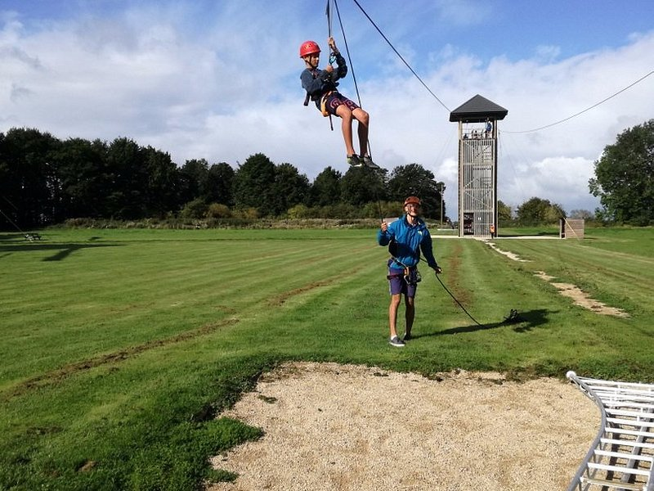
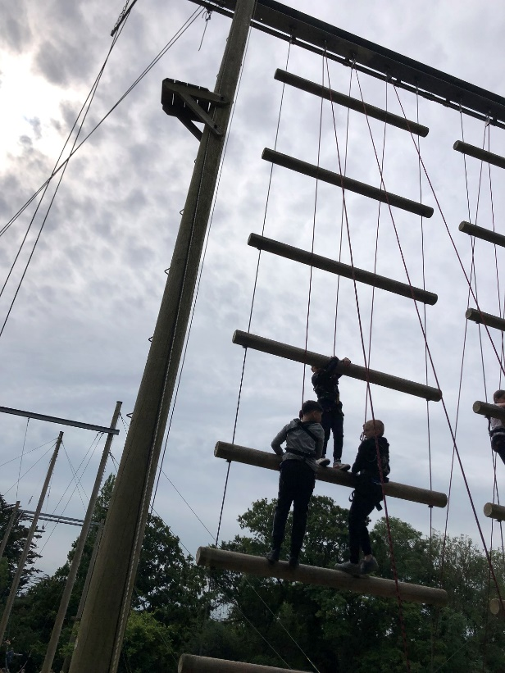
Activities
Activities:
Trapeze
Sensory Trail
Climbing
Archery
Jacob’s Ladder
Raft building
Survival
Zip wire
Evening Activities:
Gameshow
Disco

Slide 8
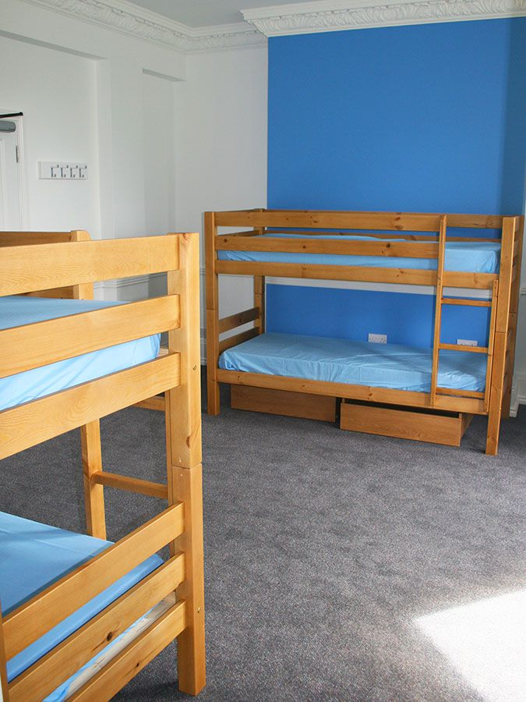
Accommodation
The children will be in rooms of up to 4.
We will ensure the children are in a group and room with someone who they wish to be with.
All rooms have a shower, sink & toilet.
Teachers’ rooms will be nearby.

Slide 9
Food
Please ensure your child has a water bottle with them, so they can fill it up everyday.
Snacks (and definitely not sweets) are not required as the meals are generous.

Slide 10
Kit List

Slide 11
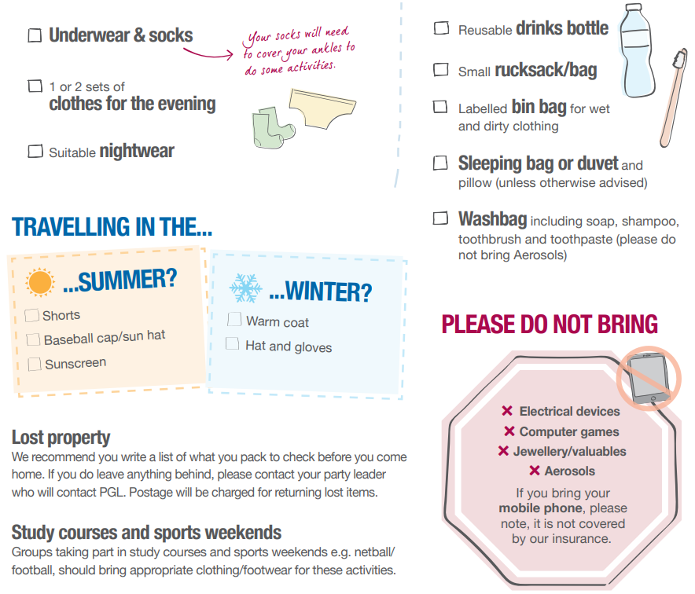
Kit List

Slide 12
Info
Children are NOT to bring any mobile phones or money with them.
Medicines will remain with teachers and be distributed when required according to the medical forms.
Children are NOT to bring any electronics with them, including iPad, kindles, hair straighteners or hair dryers.
Children must bring either a duvet or sleeping bag with a pillow.
Teddies are welcome for when going to bed.
We will take lots of pictures which will be uploaded to the school website.

Slide 13
FAQs
Can they bring spray deodorant cans?
Only bring roll on deodorant as some children suffer from asthma.
Do they need a swimming costume?
We would advise bringing a swimming costume/ trunks and a rash vest if possible as these are cooler and will be useful for water activities
Do they need to bring uniform?
No uniform required.
What about medical equipment?
Please provide any medicine e.g. travel sickness tablets/eczema cream/inhalers in a named plastic bag. All the information we need should be filled in on the sheet provided.
Do they need to bring a duvet or any other bedding with them?
Yes, they need to bring duvet or sleeping bag and pillow.
How big or small should the suitcase be that children bring?
Children need to be able to carry/wheel their own luggage.
Do children need to bring their own suncream?
Yes. This is not provided. This should also be a spray or lotion – no aerosols because of children with asthma.

