Slide 1
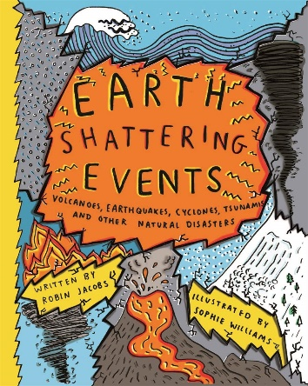
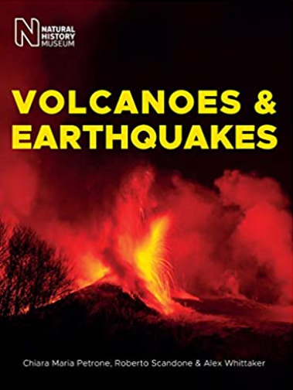
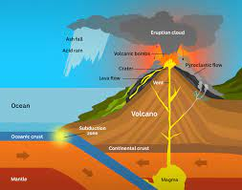
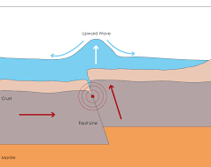
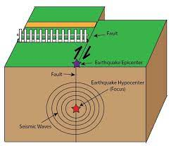
Year 6 Knowledge Mat: Extreme Earth
Subject Specific Vocabulary
Equator | An imaginary line around the middle of the globe which separates the north and the south.
Contine-nts | The world’s main continuous expanses of land (Europe, Asia, Africa, North and South America, Australia, Antarctica)
Volcano-es | A mountain or hill, with a crater or vent through which lava, rock fragments, hot vapour, and gas are or have been erupted from the earth's crust.
Earthq-uakes | A sudden violent shaking of the ground, typically causing great destruction, as a result of movements within the earth's crust or volcanic action.
Tsunam-is | A long, high sea wave caused by an earthquake or other disturbance.
The Water Cycle | The cycle of processes by which water circulates between the earth's oceans, atmosphere, and land.
The Water Cycle
Four main stages in the water cycle: Evaporation happens when warmth from the sun causes water from the sea, lakes and rivers to rise into the air and turn to vapour, which then merge together to form clouds. Condensation happens when water vapour turns back into liquid, and forms clouds in the sky. Precipitation is when water (which could be rain, snow, hail or sleet) falls from clouds in the sky. Run off happens when much of this water flows into lakes and rivers, and gets carried back to the sea.
Exciting Books
Tsunami
Earthquakes
Volcanoes

