Slide 1
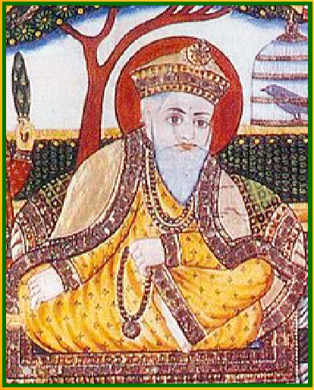
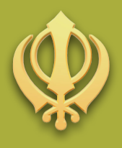
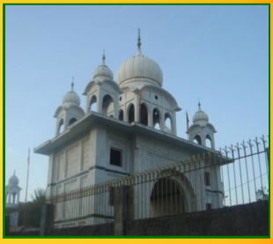
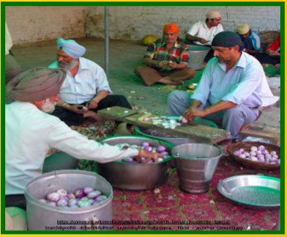
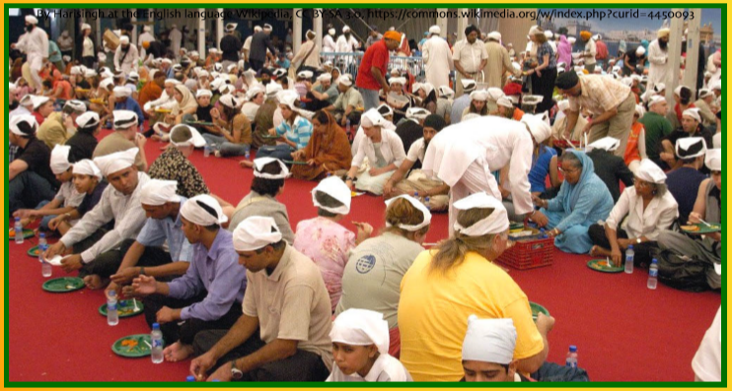
Year 6 Knowledge Mat: Sikh worship and community
Subject Specific Vocabulary
Guru | Teacher
Waheguru | The Sikh name for the one God they believe in.
Reincarnation | The belief that a soul is reborn into another body.
Mukti | A state where the cycle of reincarnation is over , and the soul can be with God.
Khanda | It represents the power of God, the idea that God has no beginning and no end, and the idea that Sikhs should ﬁght for what is right
Karma | The belief that your actions aﬀect your future reincarnation
Guru Nanak
Sikhism began in an area of India called the Punjab. It was begun around the 15th century by a man named Guru Nanak.
Sewa
In Sikhism, the act of helping someone through ‘selﬂess service’ is called sewa. Sewa is any act of kindness shown or help given to someone else, without expecting a reward or anything in return.
Mool Mantar
This is the ﬁrst piece of text in the Guru Granth Sahib. It puts into words the basis of Sikh beliefs, and is the religion’s fundamental prayer.
Gurdwara
A Gurdwara is a place where Sikhs gather together to worship and learn about God, as well as being a place of community.
Gurus
After Guru Nanak, there were nine other gurus who continued his work. They each taught others about the Sikh way of life and developed the Sikh religion. Each guru chose someone to be guru when they died.
5 Ks
In order to join the Khalsa as adults, Sikhs need to have and wear the ﬁve articles of faith, also known as the Five Ks

