Slide 1
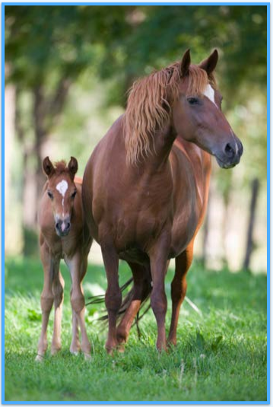
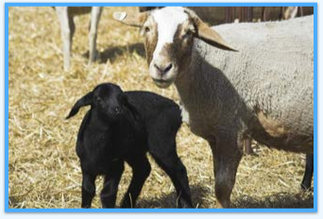
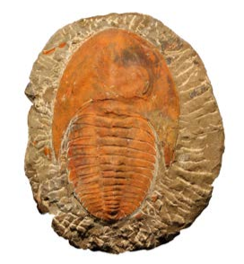
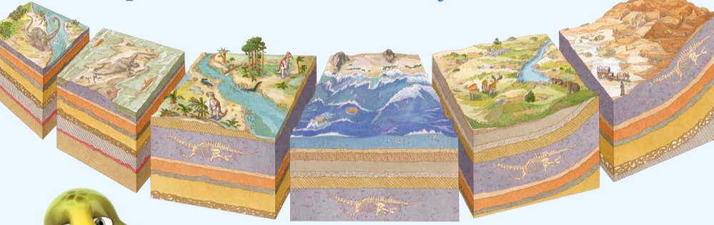
Year 6 Knowledge Mat: Evolution and inheritance
Subject Specific Vocabulary:
Inheritance | Is the name for the passing of traits, or characteristics, from parents to oﬀspring.
Characteristics | A feature or quality belonging typically to a person, place, or thing and serving to identify them.
Variation | Variation occurs in a species from generation to generation. Although an oﬀspring will have some similar characteristics to its parents, it will also have many diﬀerent characteristics. This is called variation.
Evolution | Evolution explains how all life on Earth has adapted and changed to suit its environments over time.
Species | Is a group of animals, plants or other living things that all share common characteristics and that are all classified as alike in some manner.
Mutations | Mutations occur naturally from one generation to the next in all living things..
Paloentologists | Are scientists who study fossils in rocks to learn more about how animals and plants have evolved over millions of years.
Natural Selection
Living things reproduce and become more numerous
Oﬀspring diﬀer from their parents (variation)
Some of those diﬀerences are advantageous, giving the oﬀspring a greater chance of surviving and reproducing
More oﬀspring will be born with that variation
That variation may spread through a population and change it
Sometimes, part of a population will develop diﬀerent variations, eventually forming a new species.
Sheep with white wool may occasionally produce oﬀspring with black wool
The foal has inherited a distinctive white facial marking from its mother.
The daughter has inherited her brown eyes from her father. This is not random: if two parents have blue eyes and brown eyes, it is much more likely that their oﬀspring will inherit brown eyes.
One of the main pieces evidence that helps explain the process of evolution is the fossil record. Fossils are formed over millions of years. The remains of animals have been fossilized, and layer after layer of rock built up above them as the landscape changed.
In the 17th and 18th centuries, scientists such as Carl Linnaeus were developing systems for classifying living things and developing theories which explained how living things were aﬀected and changed over time by the conditions of their environment.

