Slide 1
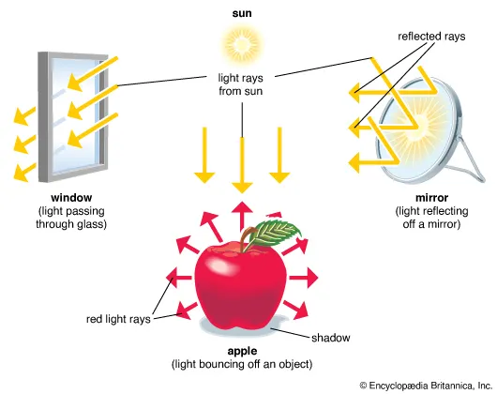
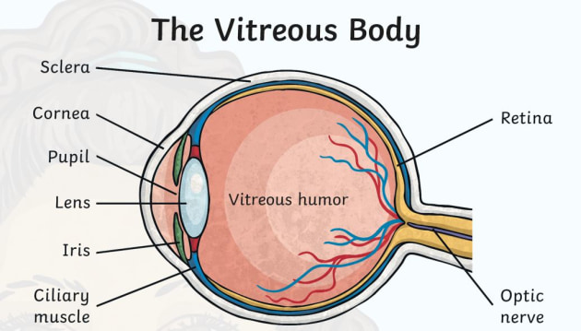
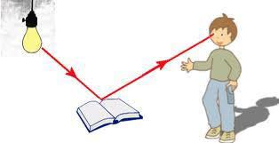
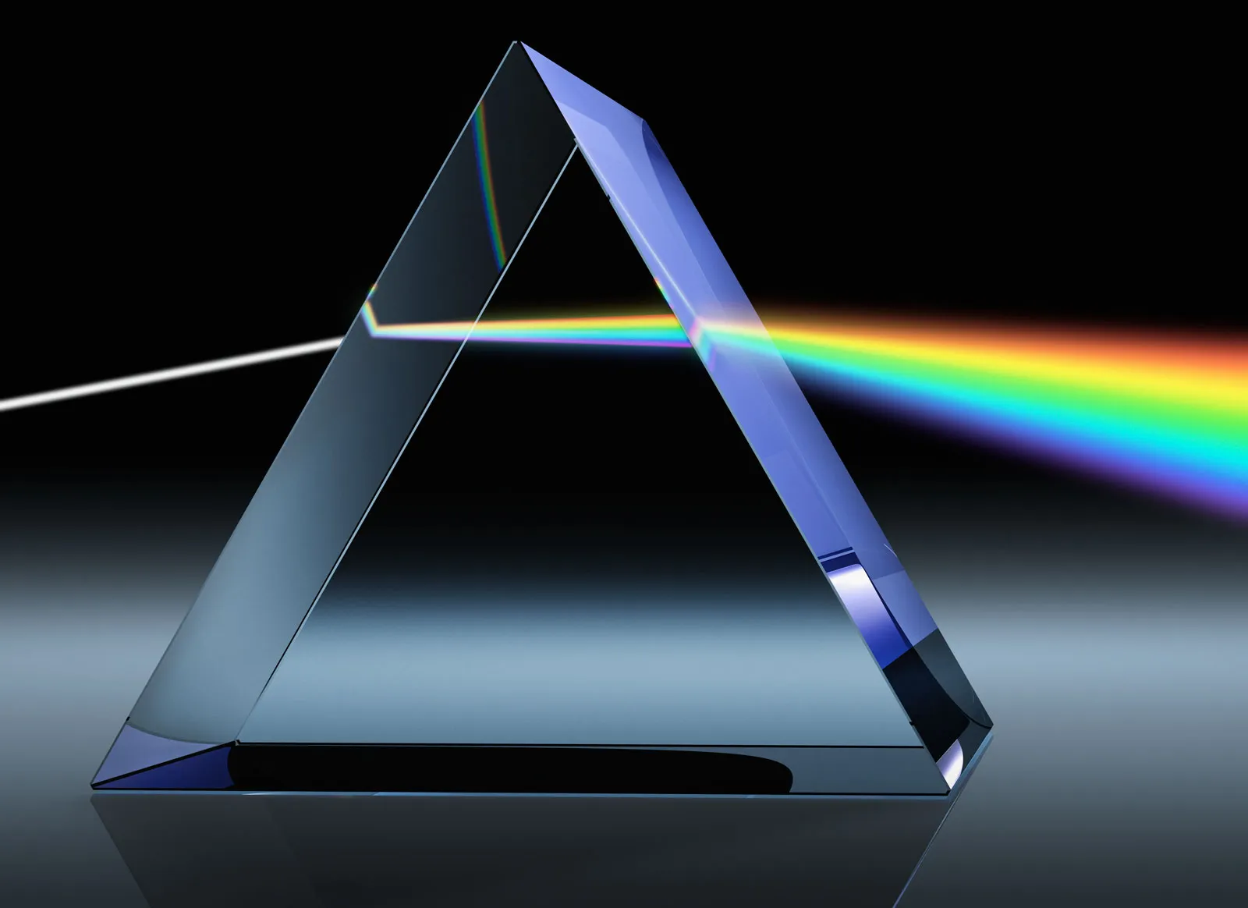
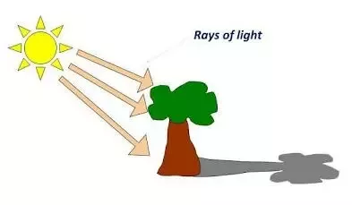
Year 6 Knowledge Mat: Light and Shadow
Parts of the eye
Subject Specific Vocabulary
Light | A type of energy that allows us to see.
Dark | The absence of light
Light Source | An object that produces light. They can be artificial or natural.
The Sun | A star that produces light in the centre of our solar system. Our main light source on Earth.
Shadow | Formed when light is blocked by a solid object
Reflection | Produced when a light beam hits a surface and bounces off in the same direction.
Colour Spectrum | The distribution of colours produced when light is dispersed by a prism.
How do we see things?
Light travels in straight lines. Objects are seen because they give out or reflect light into the eye We see things because light travels from light sources to our eyes or from light sources to objects and then to our eyes
How do shadows work?
Shadows are formed when light is blocked by an opaque object, creating a pattern of light on a surface.

