Slide 1
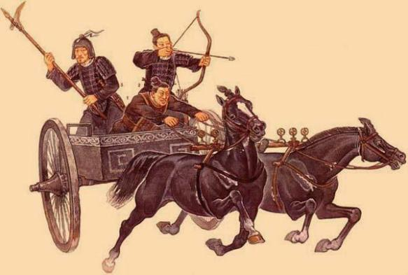
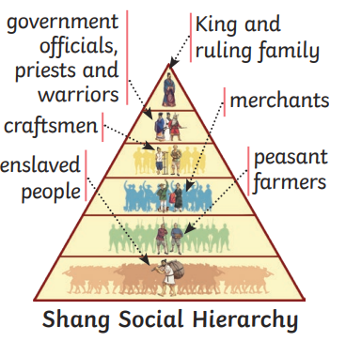
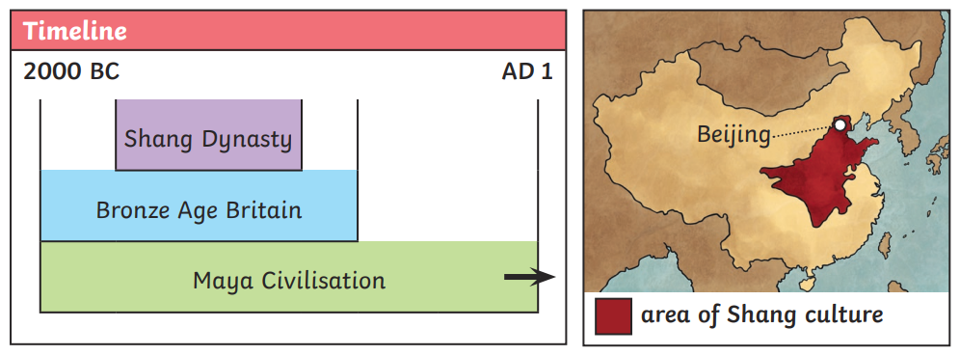
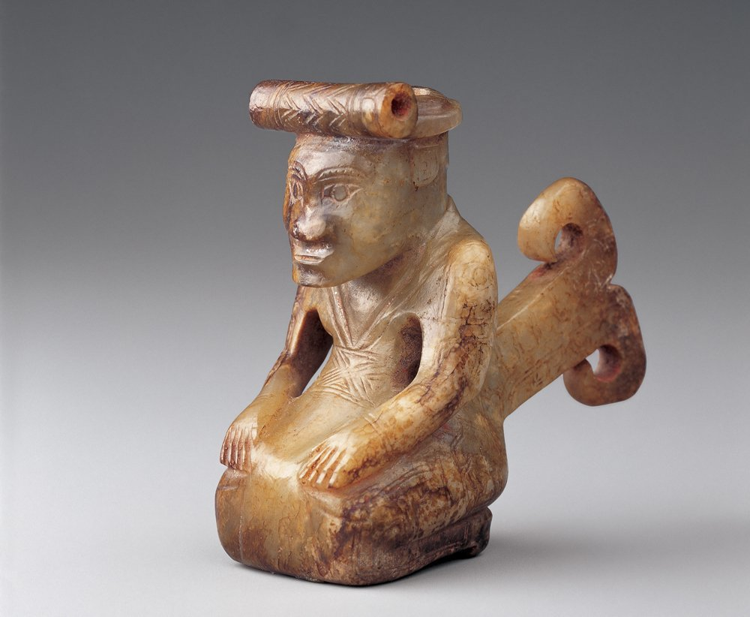
Year 6 Knowledge Mat: Shang Dynasty
Subject Specific Vocabulary
Oracle bones | Usually the shoulder bones of animals or the belly shells of turtles. Dug up centuries later by farmers, they were thought to be dragon bones and were ground up to be used in traditional Chinese medicine. In 1889, Wang Yirong and his friend Liu E worked out that the ‘dragon bones’ had been used in ancient ceremonies
Fu Hao | Not only the first known female military leader, but also the most influential military leader of her time, either male or female, responsible for leading 13,000 soldiers into battle. She was also a high priestess, which was very unusual for a woman at the time.
intact | Complete, not robbed by looters.
jade | A hard mineral stone, usually green.
bronze | A metal made from a mixture of copper and tin.
Cowrie shells | Small, flat, yellowish seashells, used like coins in trading.
artefact | An object made by a human being, typically one of cultural or historical interest.
Fu Hao’s excavated tomb
In 1976, archaeologists discovered the tomb of Fu Hao at the site of the ancient Shang capital, Yinxu. Because the tomb and its contents were intact, the discovery had a significant impact on our knowledge of the Shang dynasty and some of its people. The tomb consisted of a large pit with a wooden chamber inside containing the coffin. Evidence was found above ground of a building where memorial ceremonies and rituals were probably held in honour of Fu Hao. Thousands of items were found in Fu Hao’s tomb, demonstrating how wealthy and powerful she was. Many artefacts were from an earlier period in history, suggesting Fu Hao collected antiques. The skeletons of six dogs and 16 humans were also found in the tomb. These were probably Fu Hao’s pets and advisers, sacrificed to accompany her into the afterlife

