Slide 1
Year 6 Maths SATs Parent workshop
Thank you for coming!

Slide 2
Most common topics to appear in SATs papers
These topics appeared most frequently across the papers between 2016-2019 and 2022-2024. They are worth the most marks and conceptually make the most sense to prioritise:
Addition and Subtraction
Money
Multiplication and Division
Multiples, Factors and Prime Numbers
Place Value

Slide 3
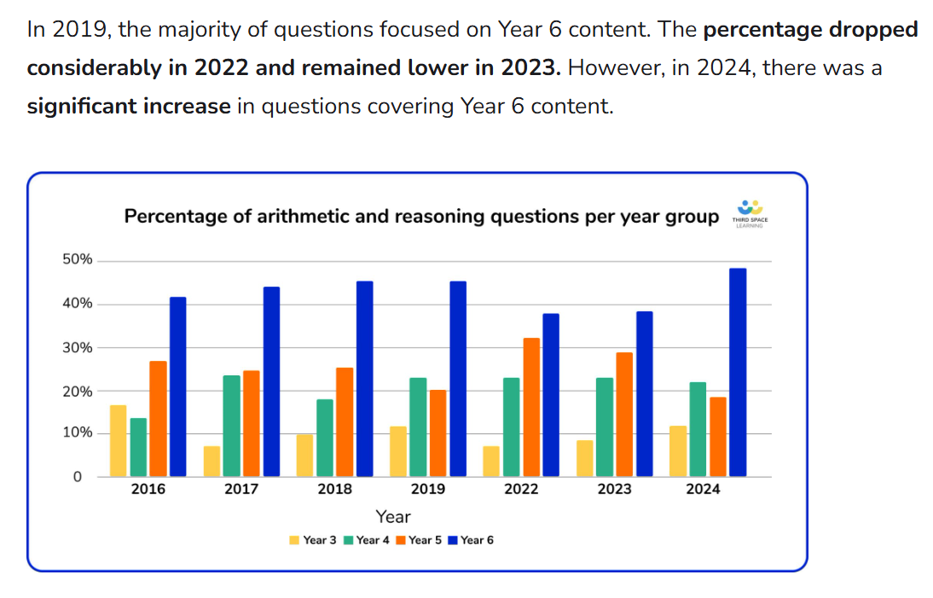
What about knowledge from other year group?

Slide 4
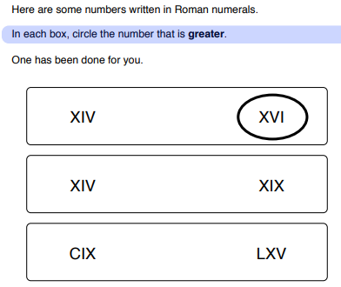
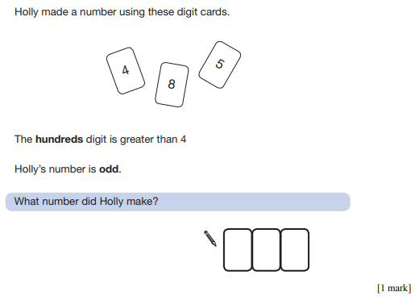
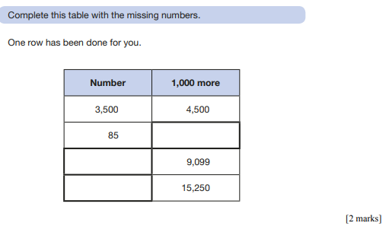
Place Value
How can I help?
Numbers to 10 million
Includes decimal numbers
Includes Roman numerals
Do they know odd and even?
Do they know the number in words?
Practice saying the number out loud!
Practice counting in 10s, 20s, 25s, 50s, 100s, 1000s, tens of thousands!

Slide 5
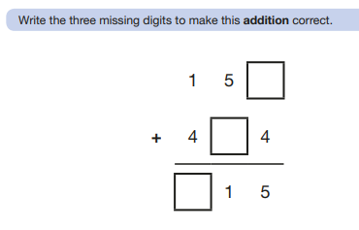
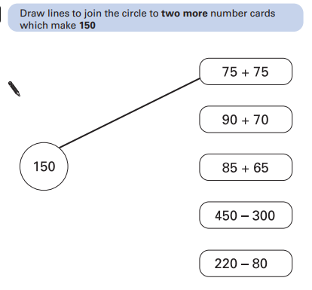
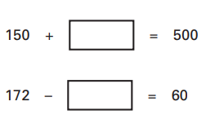
Addition and Subtraction
How can I help?
Practice number bonds to 20 – it’s all you will ever need in column addition or subtraction.
Practice column addition and subtraction.
Practice adding and subtracting numbers with different amounts of digits.
Practice adding and subtracting decimals.
Can they add/subtract 1, 10, 100 or 1000 from any number?
Practice using the inverse (opposite) to find a missing number.

Slide 6
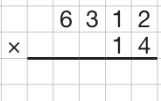
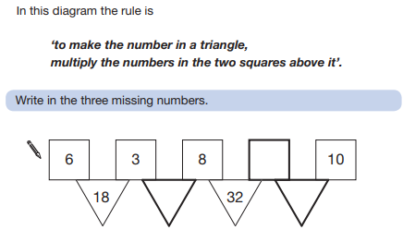
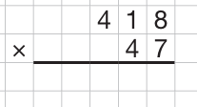
Multiplication
How can I help?
Practice times tables and the division facts.
Practice long multiplication method with a two digit number e.g. 1233 x 45
Practice multiplying any number (including decimals) by 10, 100 or 1000.
Don’t forget the zero!

Slide 7
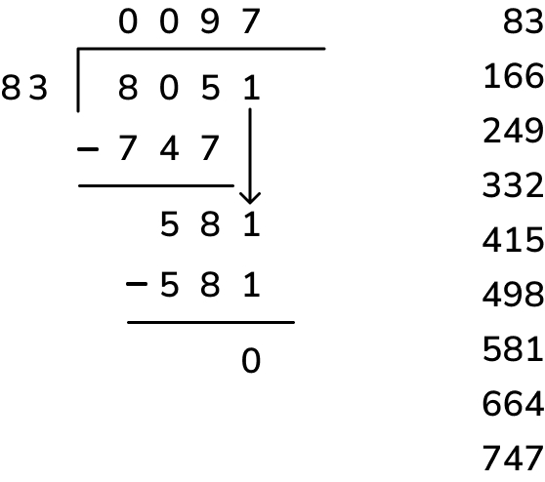
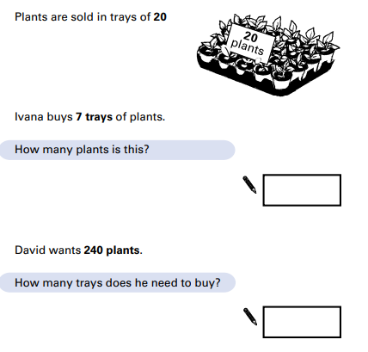
Division
D did ÷
M my x
S sister -
B burp
How can I help?
Practice times tables and the division facts.
Practice long and short division methods.
Practice dividing any number (including decimals) by 10, 100 or 1000.

Slide 8
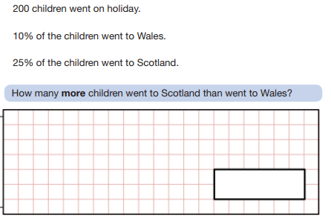
Percentages
How can I help?
Practice dividing by 10, 100, 2, 4 and 5.
Point out percentage sales in shops and see if your child can work out the discount or the price after discount.
Practice finding percentages of whole numbers.
Talk to children about links between fractions and percentages e.g. 50% = ½ so we divide by 2.
Friendly percentages!
1% = divide by 100
10% = divide by 10
20% = divide by 5
25% = divide by 4
50% = divide by 2

Slide 9
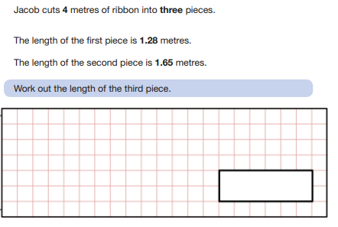
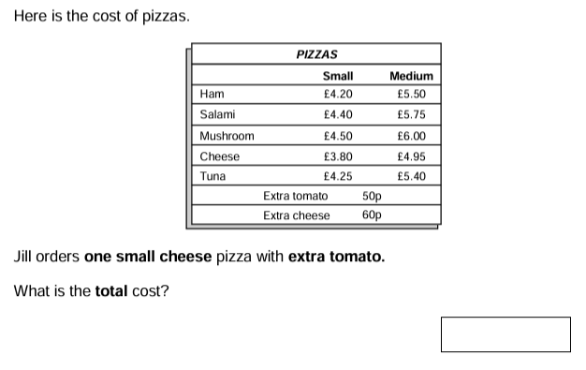
Decimals and money
How can I help?
Practice converting between pence and decimal e.g. 406p = £4.06
Practice finding change by subtracting a decimal from a whole number e.g. £5 - £1.60
Practice adding and subtracting more than one set of decimals
Practice multiplying decimals by one digit e.g. 12.4 x 3

Slide 10
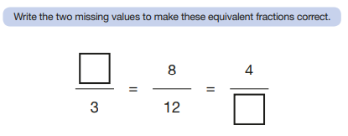
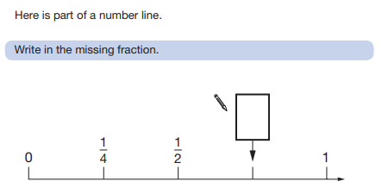
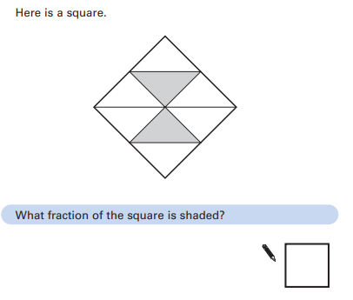
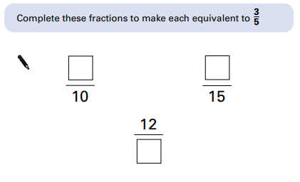
Fractions – ordering and equivalents
How can I help?
Practice putting fractions in order with different denominators
Practice finding equivalent fractions
Practice times tables

Slide 11
Adding and subtracting fractions
How can I help?
Practice finding equivalent fractions
Practice times tables
If it is a mixed number fraction, then add the whole numbers first!
Fractions with the same denominator can be added or subtracted without changing the denominator
e.g. 1/5 + 3/5 = 4/5

Slide 12
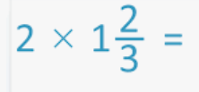
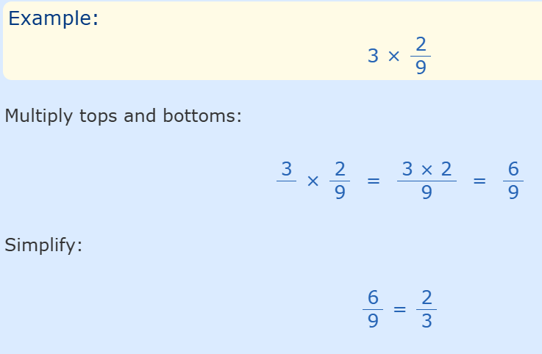
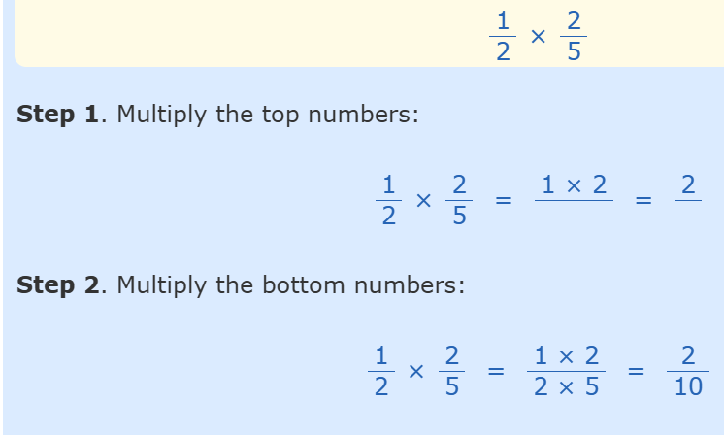
Multiplying fractions
How can I help?
Practice finding equivalent fractions
Practice times tables
Practice multiplying fractions!

Slide 13
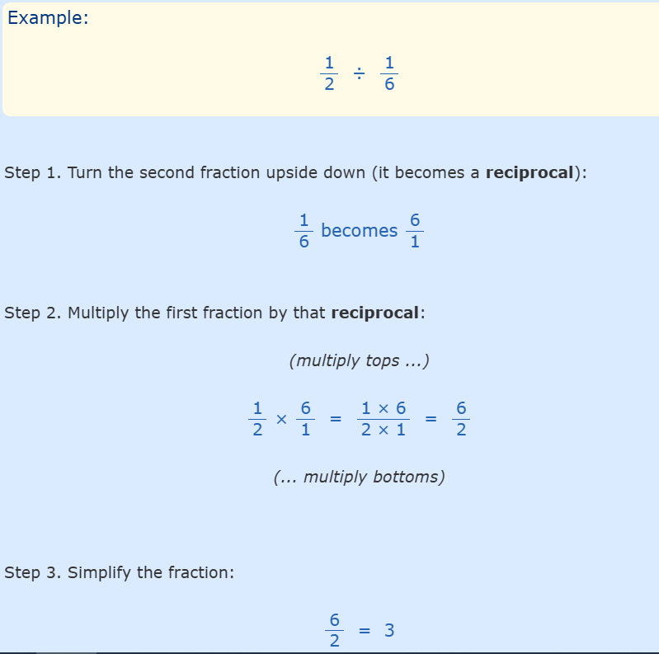
Dividing fractions
= 1/12
How can I help?
Practice finding equivalent fractions
Practice times tables and division facts
Practice dividing fractions!

Slide 14
What else could I help with?
Converting measurements e.g. cm to mm.
Telling the time on an analogue clock, digital clock and 24hr clock.
Work out times between events in a schedule.
Practice adding and subtracting negative numbers.
Talk about square, cube and prime numbers. Also the difference between a factor and a multiple.
Finding area, volume and perimeter of shapes.
Talk about symmetry and reflection of shapes.
Talk about different types of angles.
Talk about 2D and 3D shapes.
Encourage your child not to panic and try their best on the day.

Slide 15
Helpful websites
https://play.ttrockstars.com TTRockstars
https://corbettmathsprimary.com/ Videos, explanations and past papers
https://myminimaths.co.uk/year-6-mini-maths/ Mini Maths
https://uk.ixl.com/maths/year-6 Questions, explanations and tests
https://www.mathsisfun.com/index.htm Games and strategies
https://www.timestables.co.uk/ Times tables games
https://www.topmarks.co.uk/maths-games/hit-the-button Hit the button times tables game
https://www.maths4everyone.com/pages/ks2-sats-practice.php SATs questions with answers
College Town Primary school class pages have additional SATs prep too!

