Slide 1

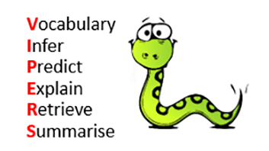
Guided Reading
Reception and Key Stage 1
Guided Reading is taught each day in a small group carousel with the teacher focusing on one group per day. Children are grouped into reading abilities. We use ‘Reading Vipers’ as a way of exploring different key skills within reading found in the National Curriculum.
Key Stage 2
In KS2 guided reading is taught as a whole class. Each year group has high-quality texts. These texts are often above the children’s reading age and have challenging vocabulary in which teachers explicitly teach to the children. The teacher reading aloud, modelling the skills of a fluent reader while each child follows along. Children then re-read the same text out loud with a partner. Activities are planned using the ‘Reading Vipers’.

Slide 2
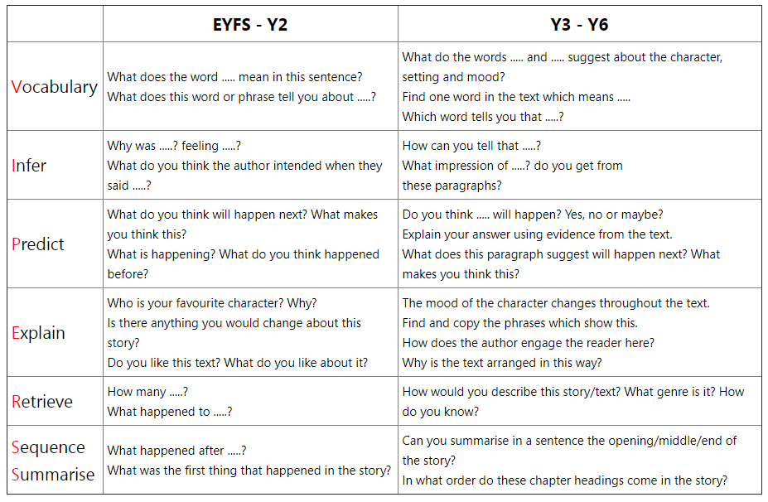

Slide 3
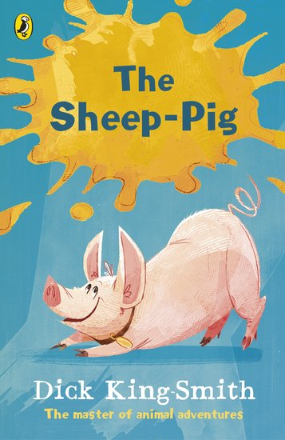
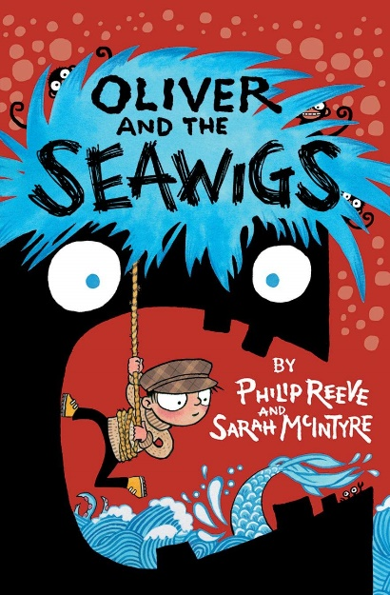



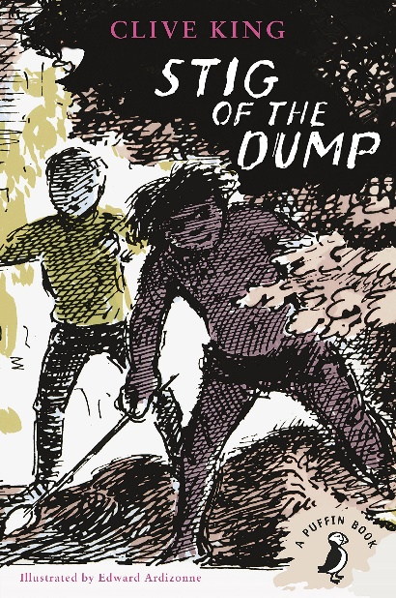


Guided Reading
Year 3
Year 4
Here are some examples of our Guided Reading books.
Year 5
Year 6

Slide 4

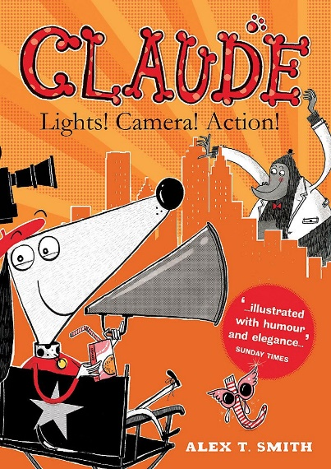
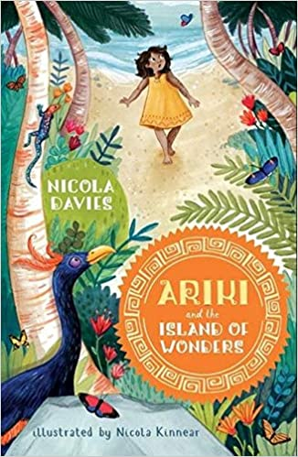
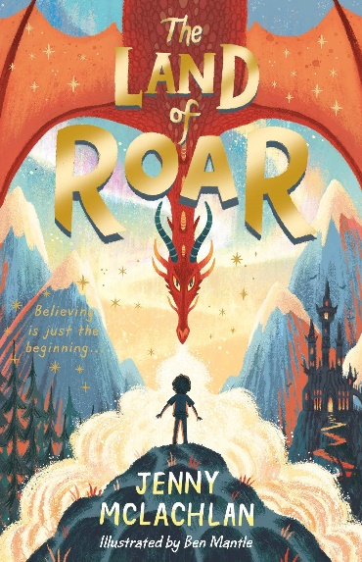
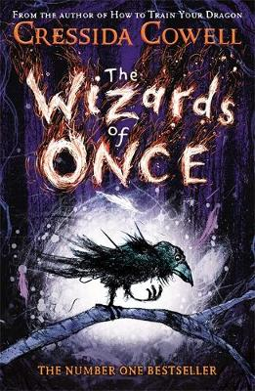
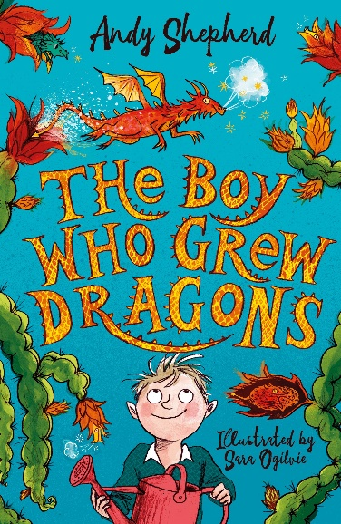
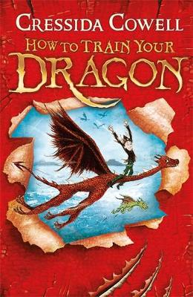





Class Readers
We enjoy reading stories to children and aim to foster a love of reading. Teachers introduce children to different stories and authors. Here are a few examples of books we read as class readers:
Year 1
Year 2
Year 3
Year 4
Year 5
Year 6

