Slide 1

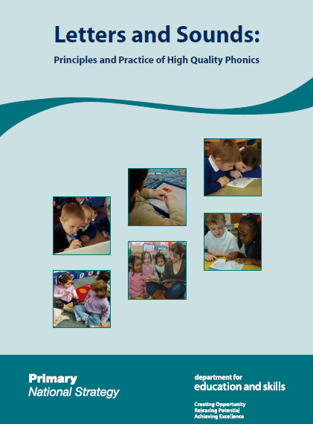
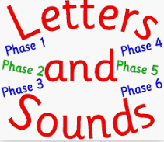
Phonics at College Town

Slide 2
What is the Letters and Sounds Programme?
Letters and Sounds is designed to help teach children how the alphabet works for reading and spelling by:
delivering systematic phonics teaching to children from the
beginning of EYFS to the end of KS1
fostering children’s speaking and listening skills as
preparation for learning phonic knowledge and skills
securing word recognition skills for children to decode (read)
and encode (spell) words accurately and so concentrate on
comprehending and composing text

Slide 3

Letters and Sounds: six teaching phases
Phase One – Nursery
Phase Two – Reception
Phase Three – Reception
Phase Four – Reception / Year 1
Phase Five – Year 1/Year 2
Phase Six – Year 2
The school expectations are that children will progress term-by-term, from Reception to Year 2 in learning phonics.
For those children that struggle to achieve this, suitable interventions are provided and then monitored by class teachers and SLT to measure their impact.
Although the six-phase structure provides a map to plan children’s progress, the boundaries between the phases are not fixed.

Slide 4
Blending
Recognising the letter sounds in a written word, for example c-u-p, and merging or them in the order in which they are written to pronounce the word ‘cup’.
Segmenting
Identifying the individual sounds in a spoken word (e.g. h-i-m) and writing down or manipulating letters for each sound to form the word ‘him’.

Slide 5
Phonics Terminology
Some definitions:
A phoneme is the smallest unit of sound in a word.
c-u-p c-a-t d-o-g

Slide 6
Some definitions:
Grapheme
Letter(s) representing a phoneme
t ai igh

Slide 7
Digraph
Two letters, which make one sound
A consonant digraph contains two consonants
sh ck th ll
A vowel digraph contains at least one vowel
ai ee ar oy
Split digraph
A digraph in which the two letters are not adjacent (e.g. make).

Slide 8
Trigraph
Three letters, which make one sound
igh dge

Slide 9
CVC words
What do you understand by the term CVC words?
On your table can you quickly make a note of ten CVC words?
C consonant phoneme
V vowel phoneme
C consonant phoneme
When writing words for children, vowels are written in red to help them understand the structure of a word.

Slide 10
Words sometimes wrongly identified as CVC
bow few
saw her
Why are these words not CVC words? Discuss…
Can you think of other examples?

Slide 11
Segmenting activity
s | l
i
p
Have a go at segmenting these words into their constituent phonemes:
shelf, dress, think, sprint, flick

Slide 12
Segmenting
WORD | PHONEMES
shelf
dress
think
string
sprint
flick

Slide 13
A basic principle in phonics
a a-e ai ay ey eigh
e e-e ea ee y
i i-e ie igh y
o o-e oa oe ow
u u-e ue oo ew
oo u oul
ow ou ough
oi oy
ar a
or aw ore a ough
air are ear
eer ear
The same phoneme can
be represented in more than
one way:
  burn
  first
  term
  heard
  work

Slide 14
Useful reading or website links
http://www.letters-and-sounds.com/
https://www.youtube.com/watch?v=vyiT8CP1M5A
Watch Mr Thorne does Phonics to learn about the importance of
clear articulation when teaching children phonics.

Slide 15
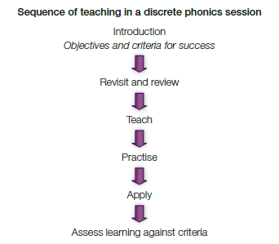
Phonics at College Town
The Letters and Sounds Phonics programme from the Primary National Strategy delivers systematic phonics teaching to children in EYFS and KS1.
In Phase 1 the youngest children learn about general sound discrimination, rhythm and rhyme, alliteration, voice sounds, oral blending and segmenting.
The programme consists of six phases which are delivered starting in the school Nursery at Phase 1, through to Year 2 who concentrate mainly on learning Phase 6.
In Phases 2 – 5 there is a discrete daily teaching session with a specific structure to ensure that children become proficient in blending and segmenting for reading.
In Phase 6, Year 2 children learn about the past tense, investigate ad learn suffixes, find and learn the difficult parts of a word, learn to spell longer words, then begin to apply spelling rules in their own writing.
As children move through the phases they are taught to: remember the sound for letters, digraphs, and trigraphs; blend and segment the sounds in words; read high frequency (common) words; learn letter formation; and learn the rules for spelling.
Year 1 children undertake a Phonics Screening Check. Those children who do not pass have interventions and retake in Year 2.

