Slide 1


A Deep Dive into Reading

Slide 2
Our philosophy
What are we looking for in reading?
We want all our children to read fluently and quickly.
Why do we want our children to read quickly?
Fluent readers learn more!
Why are we trying to foster a love of reading?
Choosing to read is the highest indicator of future achievement in education.

Slide 3

Reading at College Town
Children visit the school libraries at least once a week, to look at books and to choose one to take home.
Children have the opportunity to read books about their year group topic and discuss these with the teacher and with other learners in the class.
Guided Reading takes place in KS 1 and 2 to teach children the skills needed to become a fluent reader. Children are read quality texts by the teachers which they then read aloud independently.
We use Letters and Sounds to deliver the schools systematic teaching of Phonics. We identify the teaching strategies for teachers to use to ensure consistency. CPD for staff is provided so that staff are confident and informed.
Daily Phonics teaching takes place from EYFS to the end of KS 1 to ensure children can learn to read by blending and segmenting sounds.
Class readers are read by teachers at the end of the school day. Teachers ensure that story time is engaging and that children are progressively challenged with more difficult stories and poems.
The school expectations are that children will progress term-by-term, from Reception to Year 2 in learning Phonics. For those children that struggle to achieve this suitable interventions are provided and monitored.
Priority Readers is a whole school strategy that ensures children are given the help needed to make progress. These children read with an adult every day and are monitored closely to ensure they are able to keep up.
The Simple View of Reading is used in KS1 and KS2 to identify gaps and address weaknesses in children’s reading ability and understanding.

Slide 4
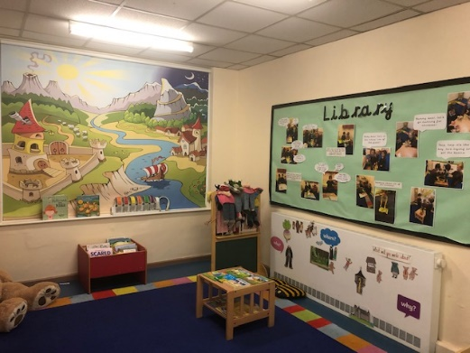
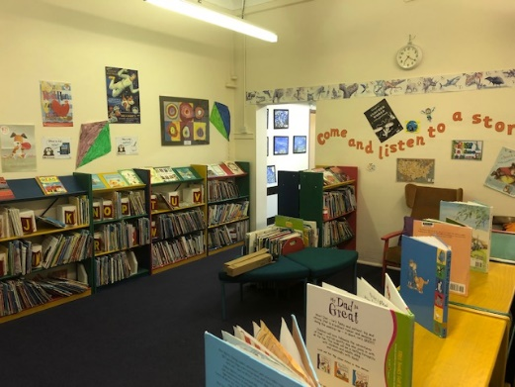
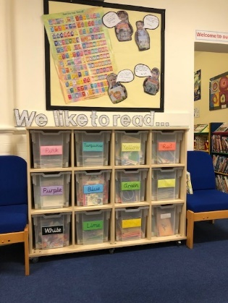
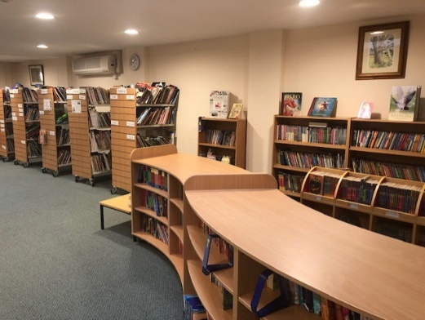
EYFS
Reading at College Town
As a large split site school College Town has three libraries for children to select books from in EYFS, KS 1 and in KS 2.
KS 1 complete a Guided Reading session every day, where teachers hear children read and assess progress and understanding. Children consolidate other reading skills in these sessions in a carousel of planned activities.
KS 1
In EYFS and KS 1 reading books are changed every Monday.
In KS 2 children change and select new books when it is their library slot.
KS 2 complete a Guided Reading session four days per week. The focus is on whole class teaching with the teacher reading aloud pre-selected quality texts to the class. The children then read the text aloud with a partner and answer questions linked to Literacy Shed –
VIPERS reading skills.
KS 2
Reading books are carefully selected in KS 1 so as to closely match the phonic phase children are working at.

Slide 5
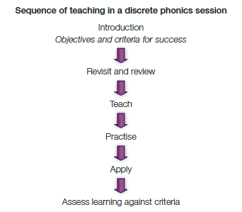
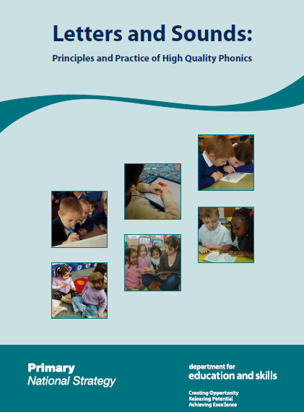
Phonics at College Town
The Letters and Sounds Phonics programme from the Primary National Strategy delivers systematic phonics teaching to children in EYFS and KS1.
In Phase 1 the youngest children learn about general sound discrimination, rhythm and rhyme, alliteration, voice sounds, oral blending and segmenting.
The programme consists of six phases which are delivered starting in the school Nursery at Phase 1, through to Year 2 who concentrate mainly on learning Phase 6.
In Phases 2 – 5 there is a discrete daily teaching session with a specific structure to ensure that children become proficient in blending and segmenting for reading.
In Phase 6, Year 2 children learn about the past tense, investigate and learn suffixes, find and learn the difficult parts of a word, learn to spell longer words, then begin to apply spelling rules in their own writing.
As children move through the phases they are taught to: remember the sound for letters, digraphs, and trigraphs; blend and segment the sounds in words; read high frequency (common) words; learn letter formation; and learn the rules for spelling.
Year 1 children undertake a Phonics Screening Check. Those children who do not pass this have tailored interventions and retake the PSC in Year 2, in June of the following year.

Slide 6
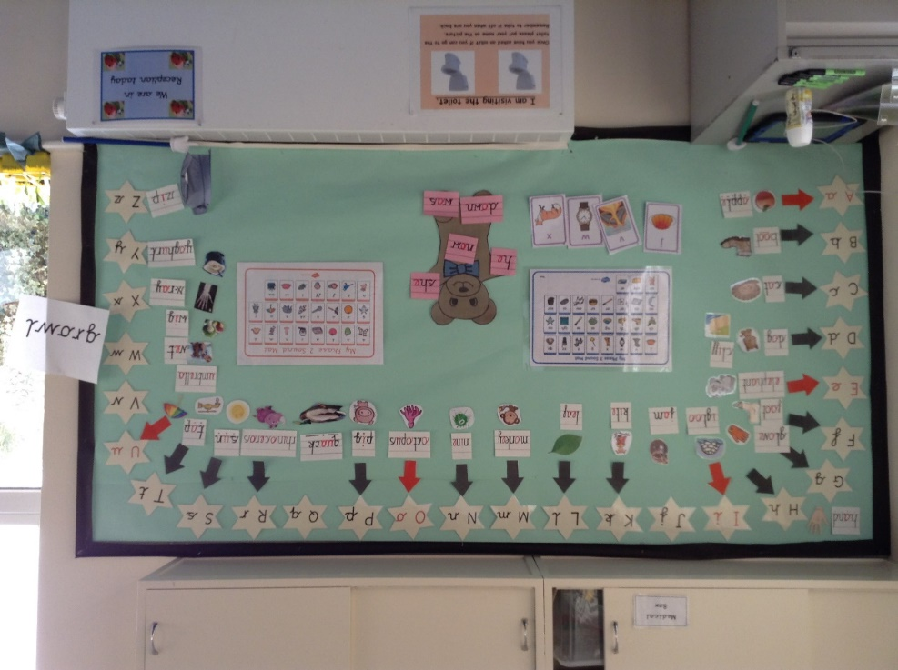
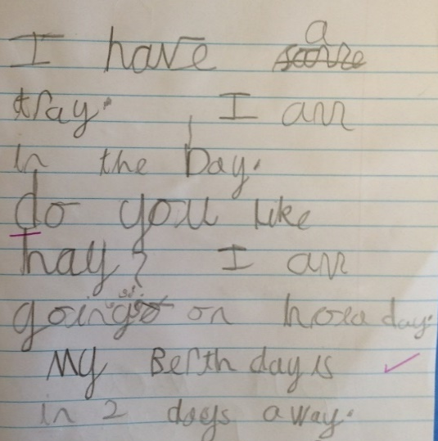
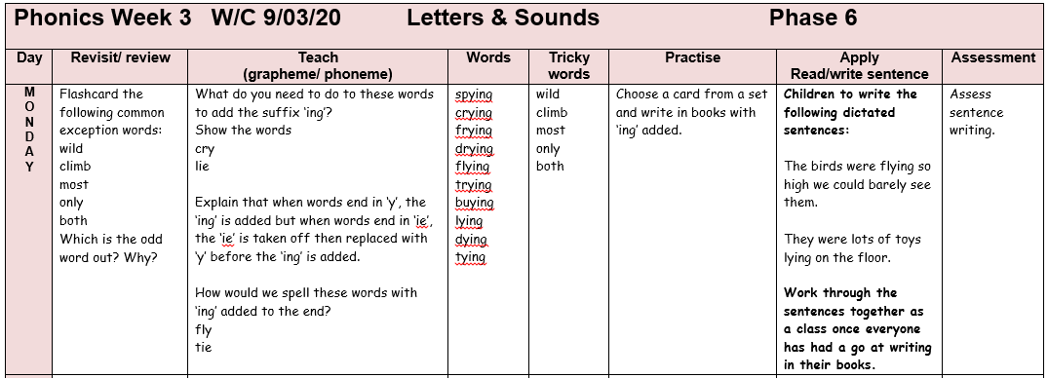
Phonics lessons
Each day, children have a fast-paced phonics lesson. The strategies all adults use are taken directly from the Letters and Sounds phonics programme.
Teachers make regular phonics assessments to ensure term-on-term progress is made. The outcomes are recorded on a Phonics Tracker so that staff can quickly identify those children that need more support to keep up.
All phonics sessions are organised into the same sequence: revisit/review, teach, practice, apply and assess.
Children identified as making the slowest progress have interventions with a teacher or teaching assistant.
Adults speak articulately and model clear, precise spoken language for the children in their class.

Slide 7
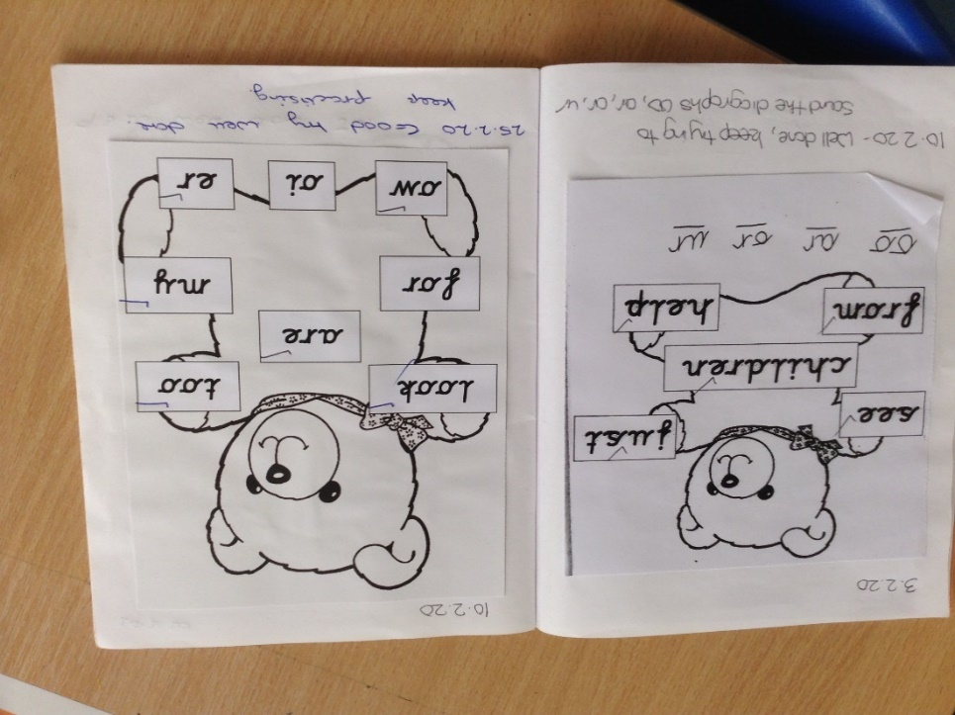
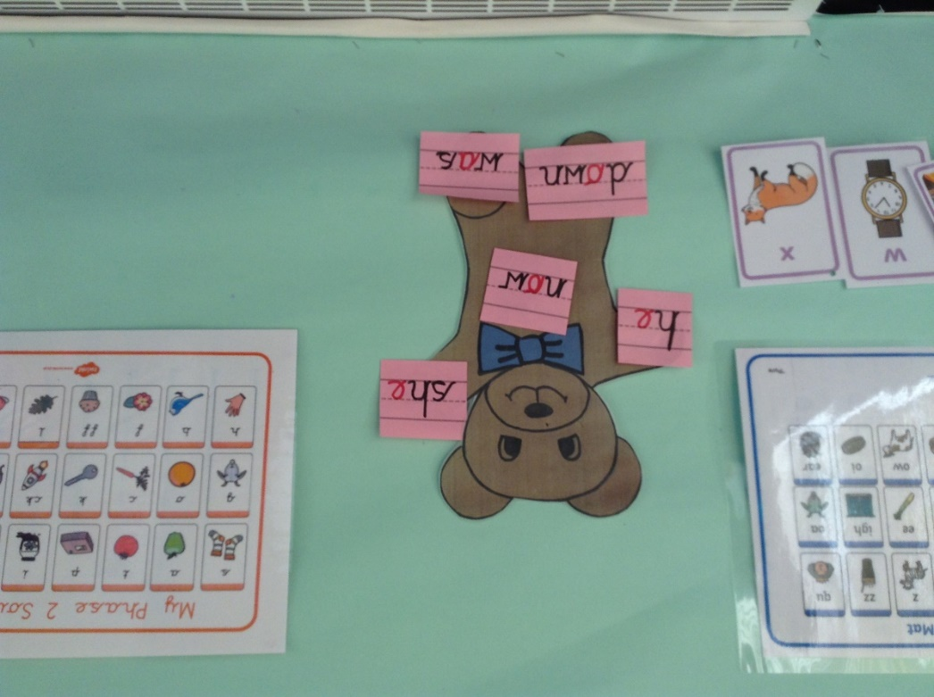
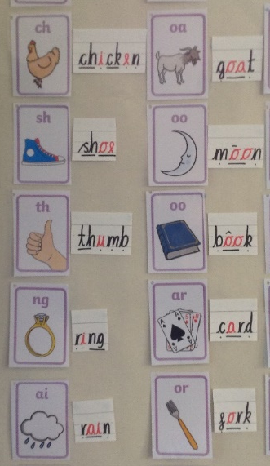
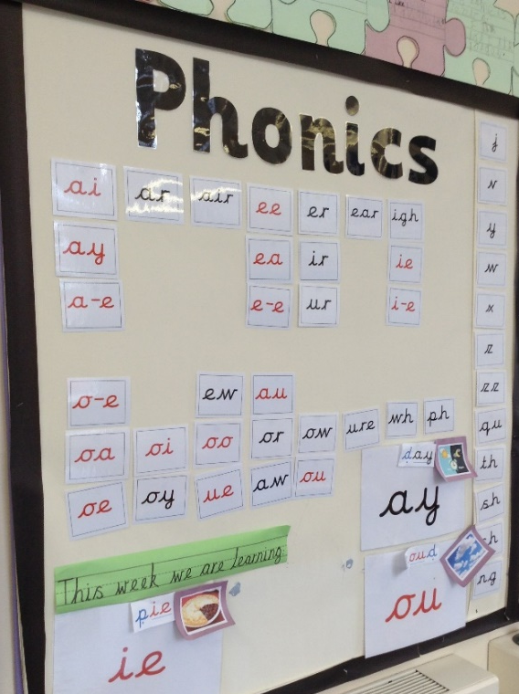
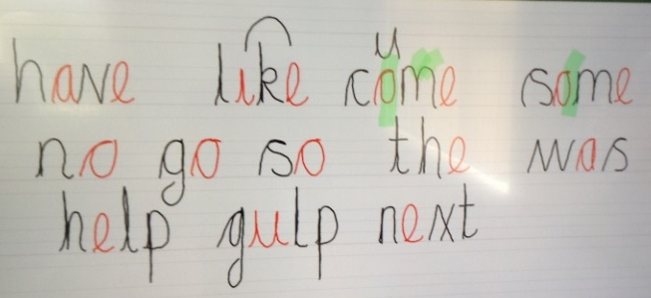
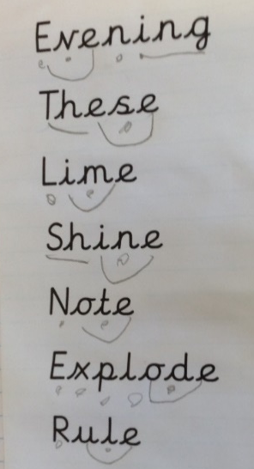
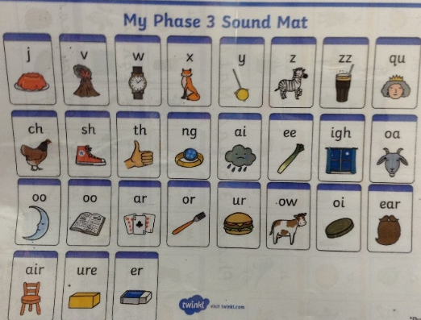
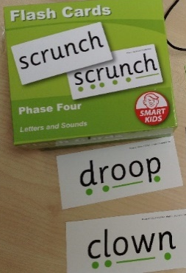
Phonics lessons
When writing words with the children, vowels are written in red so children can understand the structure of a word.
In Reception, children have a Teddy words session each day to develop their sight vocabulary alongside their phonological awareness. These words are sent home weekly with the phonic sounds they have been working on in class.
We introduce children to text marking. We put ‘buttons’ or ‘zips’ underneath the words.
Resources and working walls are used as visual support for children’s learning.

Slide 8
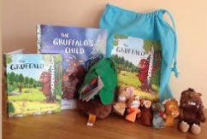
Parent Partnerships at College Town
Recommended reads list for parents - authors and age -appropriate books. Shared at parents meetings and on our school web-site.
Reading volunteer scheme to younger year groups- to involve people in the community sharing stories with children..
Provision of story sacks for Reception children to enjoy in school and at home..
Reading events for parents and children throughout the school year.
Information on school website: to communicate reading presentation and workshop dates, reading information that can be downloaded, photographs to celebrate the success of reading events.
Raising the profile of reading around the school - through displays, presentations, competitions, information. v
Home language/ bilingual story sessions involving qualified bilingual adults and also enlisting the help of all parents in reading stories to young children.
Reception library opened up each week for children to choose a book to take home and read with parents.

