Slide 1





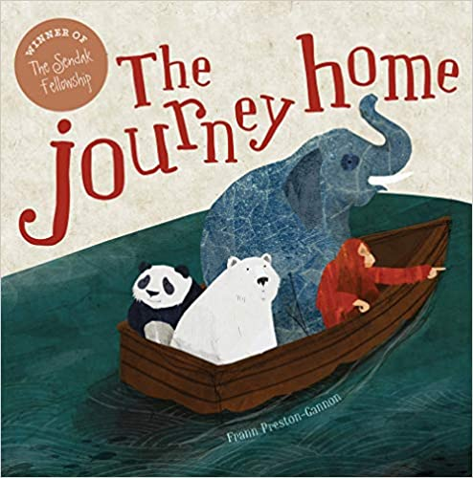
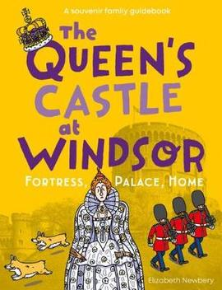
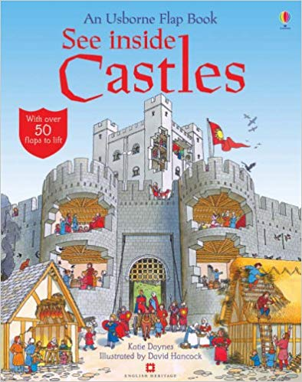








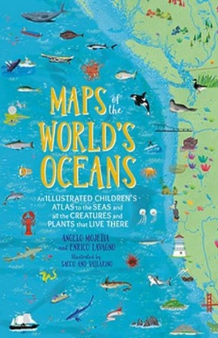
Year 2 – Reading across the curriculum
History of Flight
Home and Abroad
Windsor
United Kingdom
Explorers
Continents and Oceans

