Slide 1







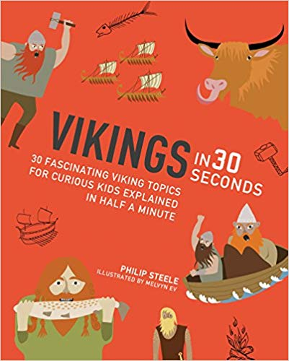
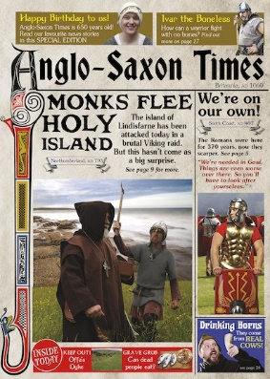









Year 4 – Reading across the curriculum
Reading a Map
The Ancient Romans
Anglo Saxons, Scots and Vikings
The Environment
The Tudors
What is our place within Europe?

