Slide 1
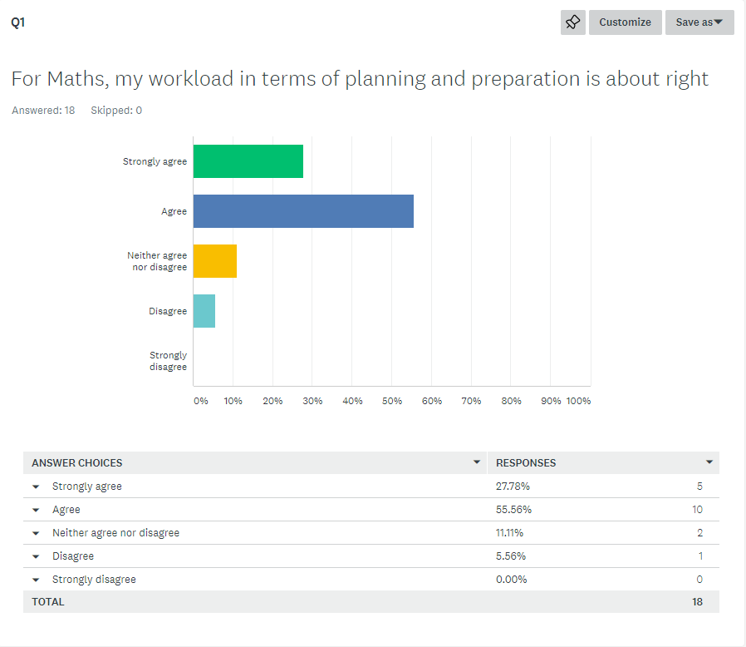
Very positive outcome: one of the main reasons for changing the process was to ensure a better balance for staff.

Slide 2
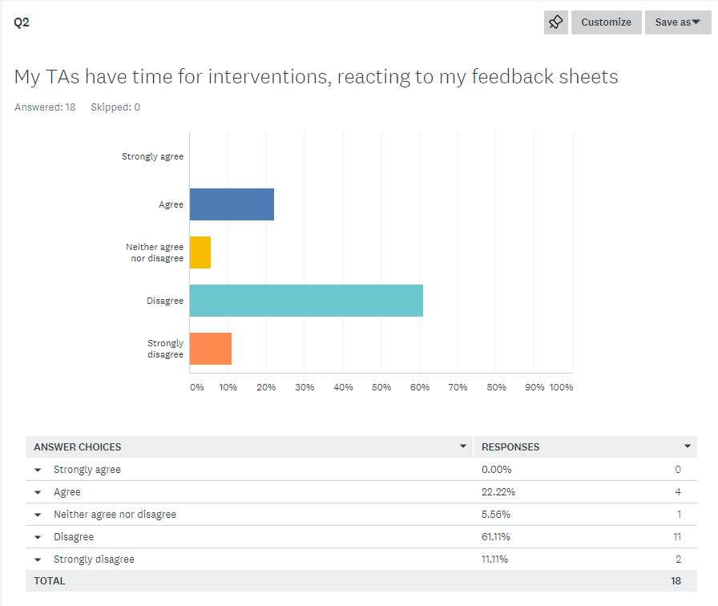
This is something we are going to have to dig further into; the next slide gives more context.

Slide 3
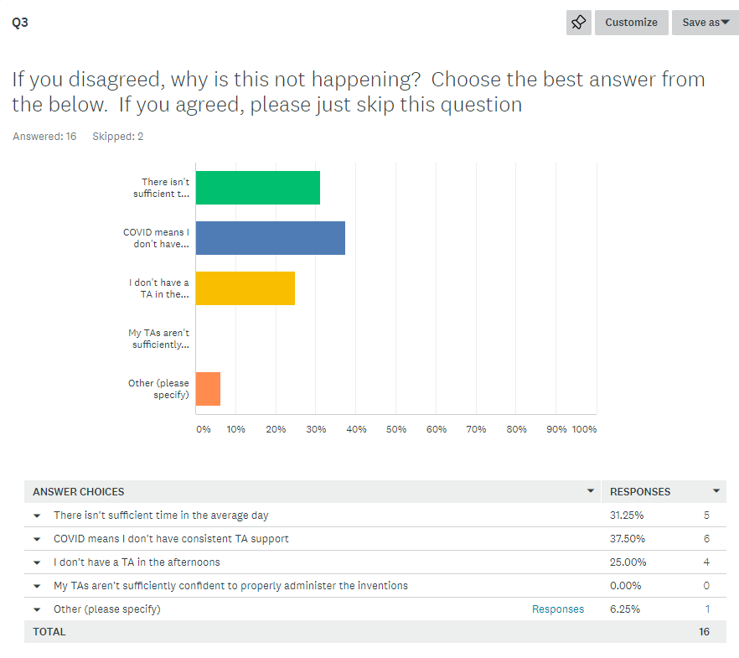
The first and third point can be overcome with better timetabling which is something that can be discussed and targeted as part of our next INSET. Obviously, the fallout of COVID is going to continue for some time yet so we will just have to continue to mitigate these as best we can.

Slide 4
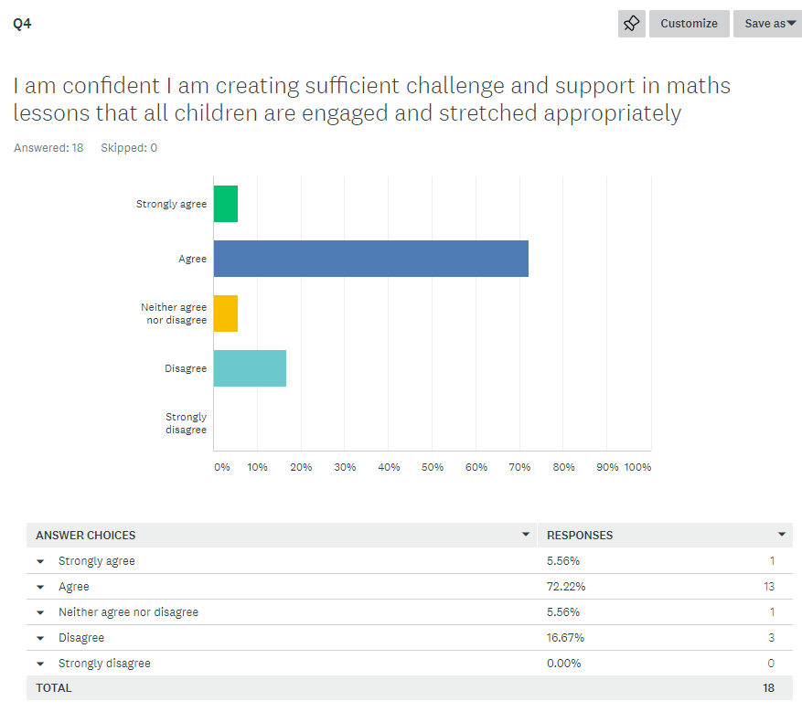
Challenge and support are essential to the make-up of or maths lessons (as all children are doing the same task). It’s very encouraging that such a large % agree that this is being met. What I need to do now is find out, from those who disagree whether it is the support, the challenge or both that they are struggling with.

Slide 5
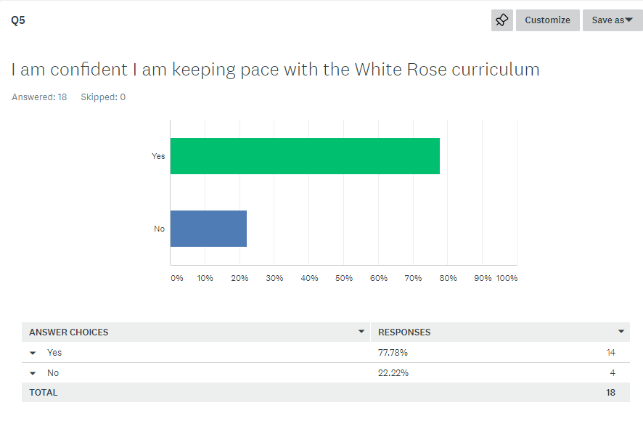
Keeping pace with the curriculum is vital but it does move very quickly – when I share this information with staff I will request that anyone who is falling behind is liaising with me so we are able to create a pathway to ensure this isn’t to the detriment of the children.

Slide 6
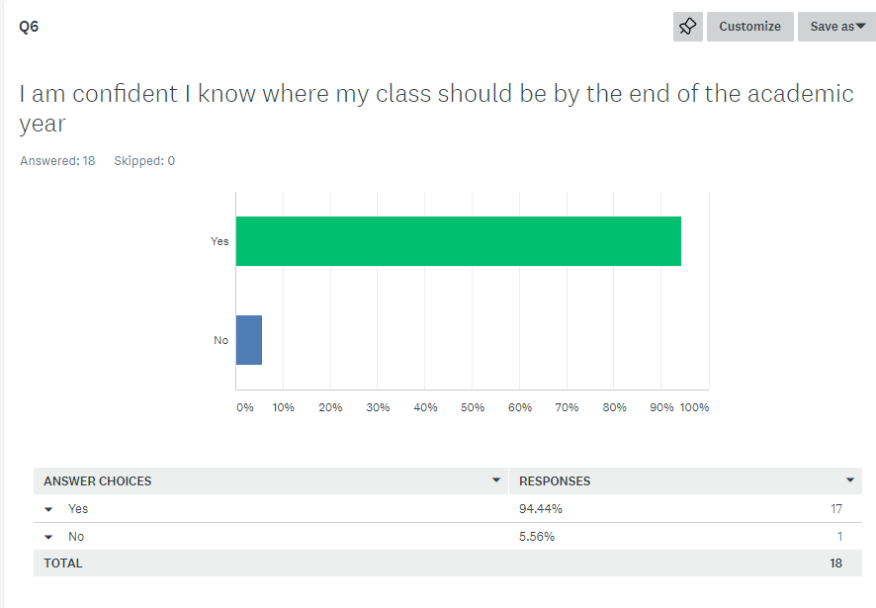
This is fantastic.

Slide 7
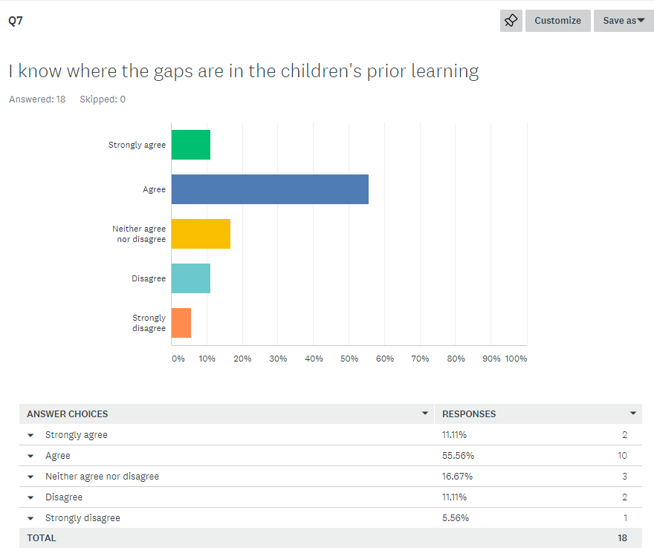
Data generated from assessment is essential to ascertaining where gaps in children’s knowledge is. As we move through this year, one during which we are introducing a more formal assessment structure, I would expect teachers confidence to improve in this area.

Slide 8
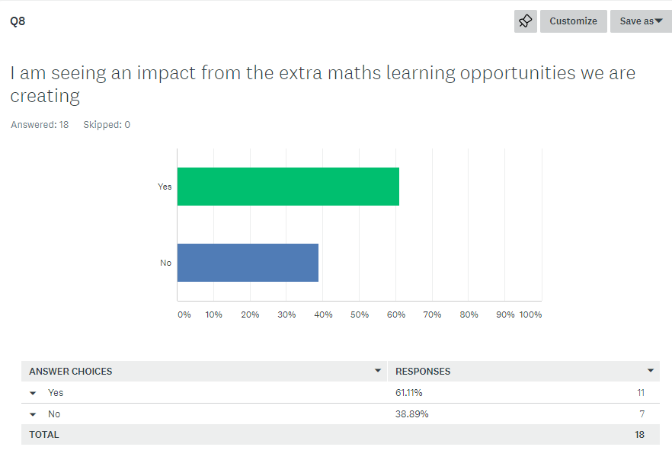
We have already made some changes to the homework clubs to ensure teachers have a better understanding of what is being covered. As well as this, it is very earl days for the in class extra learning we have put in place.

Slide 9
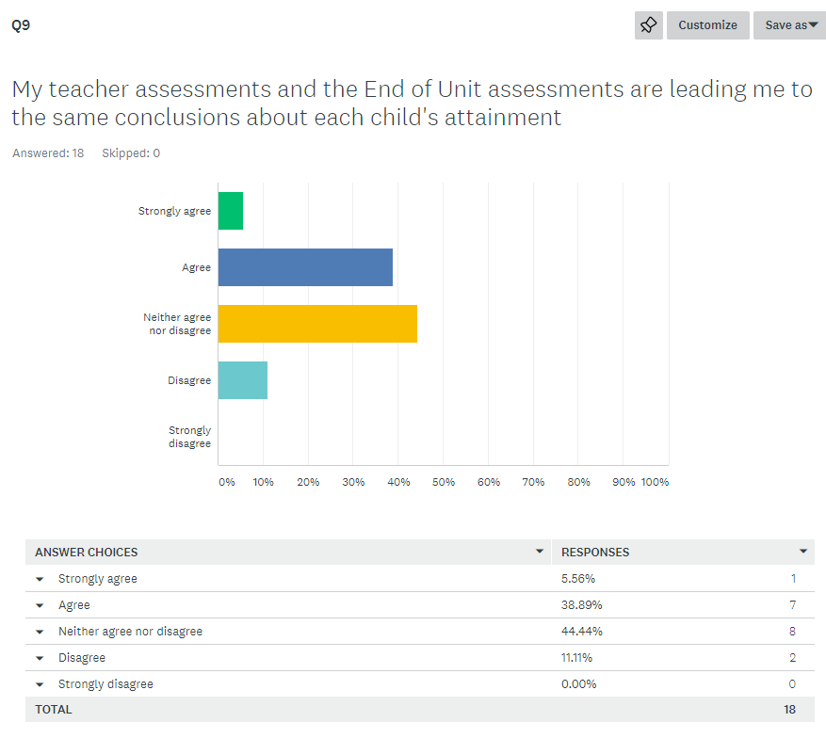
The White Rose assessments are very tricky and move quickly away from fluency questions and into the realms of reasoning and problem solving. This means that the data can occasionally suggest a learner isn’t quite as comfortable as a teacher may have perceived. As mentioned earlier, this is the first year of moving into a more structured approach to assessing maths progress so I am not surprise by this data.

Slide 10
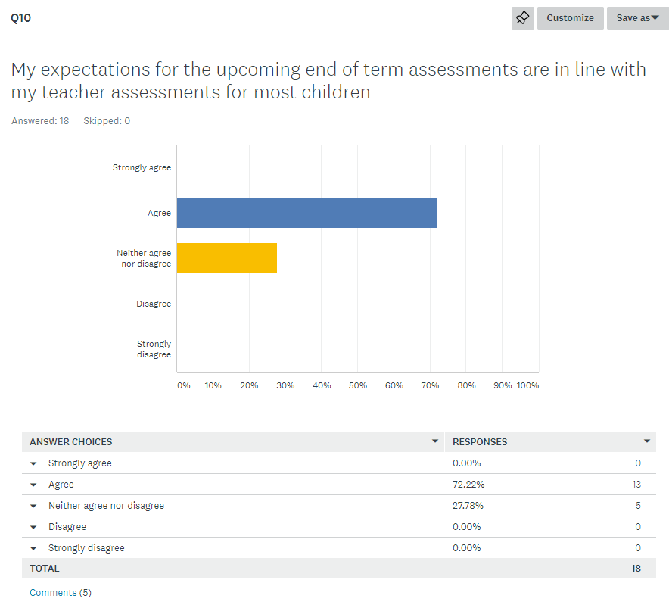
Linked to the previous question, the whole year picture is good. Teachers are confident in their assessment predictions (though this latest lock-down may put things back again!)

