Slide 1

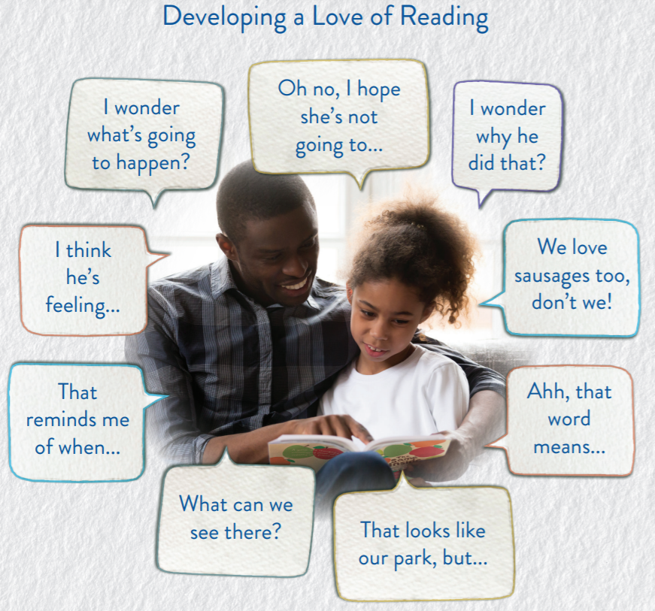
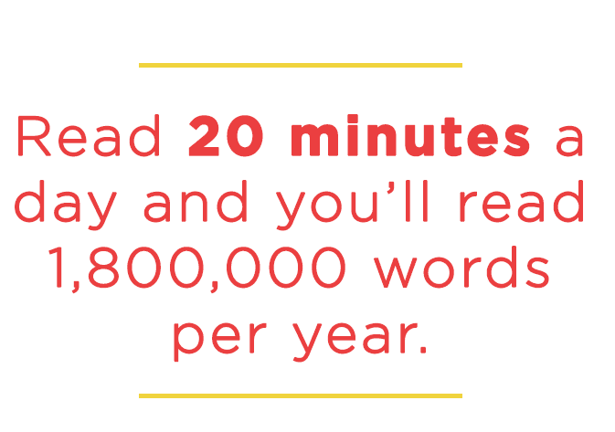
Reading Newsletter at College Town Primary
Autumn Term 1
Each half term, we will be sending out a Reading Newsletter to inform parents/carers on ways to support with reading at home.
How can I help my child?
As a parent, you can play an important role in helping your child learn to read. Research shows that children who are helped at home make better progress in school.
Book-related talk introduces children to language they might not hear in ordinary conversations.
Open questions, comments and prompts invite your child to make connections and share their views. Sharing stories together develops language, comprehension and reading for pleasure.

Slide 2
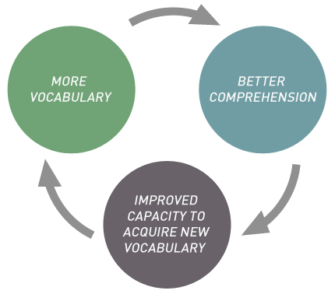
Importance of Parental Engagement with Reading
Research shows that reading with your child is the single most important thing you can do to help your child's education.
‘Parents who engage their children in books prepare them to become committed and enthusiastic readers: they can transform their attitudes to reading.’ The Reading Framework, 2021
Through reading and hearing stories, children are exposed to a rich and wide vocabulary. This helps them build their own vocabulary and improve their understanding.
If you can’t read 5% of words in a text the meaning becomes lost. This is why it is so important to read with your child to help them overcome unfamiliar or tricky words, so that they understand what they are reading.

