Slide 1
Key changes to the inspection handbooks for September 2021
Ofsted Inspections from September 2021

Slide 2
Summary of changes
Extension of the statutory inspection window to 7 years for a school’s first inspection following the pandemic, and extension of Ofsted’s internal windows for outstanding schools, good schools, RI schools, new schools and schools causing concern (6 terms added).
New section on Careers information, education, advice and guidance.
New section on Sexual harassment, online sexual abuse and sexual violence.
New references to the ‘transitional period’ (Sept 2021-March 2022)
New paragraph on how inspectors will look at the use of tutoring.
Other significant changes & the Section 8 handbook changes.
(Plus a reminder at the end about initial inspections of outstanding schools)

Slide 3
Which schools will be inspected from September 2021?
Ofsted has confirmed a full programme of graded inspections will resume in autumn 2021.
This means that Section 5 and Section 8 inspections are expected to be taking place.

Slide 4
Section 5 : September 2021
This slide deck outlines the changes Ofsted has made (as of June 28th 2021) to the Section 5 inspection handbook ahead of September 2021.
It’s worth remembering that previous changes have been made to this handbook during the pandemic as inspection activity has been adapted. This slide deck only outlines the most recent changes made in June 2021.
Red text shows where wording has been added/updated

Slide 5
Timing of Inspections
Timing of inspections –extension of inspection window
As anticipated, paragraph 41 has been updated to state: “The regulations set the interval for section 5 inspections as within 5 school years (for a school’s first inspection following the pandemic, this will instead be 7 years) from the end of the school year in which the last section 5 inspection took place.”
55. The EIF supports proportionate inspections of schools’ performance and circumstances. Maintained primary and secondary schools and academies that were judged good or outstanding at their previous section 5 inspection will normally receive an inspection under section 8 approximately every 4 years. For the first inspection after the pandemic, this period will be extended by up to 6 terms. This is to confirm that the quality of education remains good or outstanding
65. Maintained schools that become academies are normally treated as new schools for inspection purposes and are subject to a section 5 inspection as their first inspection. This will normally take place within 3 years of the new school opening. For the first inspection after the pandemic, this period will be extended by up to 6 terms. New converter academies whose predecessor schools were most recently judged good or outstanding are eligible for an inspection under section 8 of the Education Act 2005, as described in the section 8 handbook.

Slide 6
Timing of Inspections for RI schools
147. A school that is judged as requires improvement (overall effectiveness grade 3) is a school that is not good but overall provides an acceptable standard of education. The judgement of requires improvement is not a formal category of concern, but the school may be subject to monitoring by Ofsted. This will not normally apply to a school that has been judged as requires improvement for the first time. We will inspect the school again under section 5, usually within 30 months of the publication of the previous section 5 report. For the first inspection after the pandemic, this period will be extended by up to 6 terms.
149. If, at the next section 5 inspection, the school has not demonstrated that it has improved to good, the lead inspector will need to consider whether the school continues to require improvement or may be inadequate. If the school has demonstrated improvement in some areas and there is a general upward trend, but key aspects of performance remain less than good, the school may be judged as requires improvement again. In that case, there will normally be monitoring before another section 5 inspection takes place within 30 months of the publication of the previous section 5 report (for the first inspection after the pandemic, this period will be extended by up to 6 terms).These considerations will be made at each section 5 re-inspection of a school that was previously judged as requires improvement.

Slide 7
Timing of Inspections for schools causing concern
164. Whether becoming a new academy or being brokered or rebrokered, these schools will become new sponsored academies. We will then inspect them as new schools within 3 years of operation and normally in the third year (for the first inspection after the pandemic, this period will be extended by up to 6 terms). However, in exceptional circumstances, schools that are becoming new academies or being rebrokered may receive a section 8 inspection before their next section 5 inspection.
165. Academies judged to have serious weaknesses, and which are not brokered or rebrokered, will be subject to monitoring by Ofsted. They will normally be re-inspected within 30 months of the publication of the inspection report in which they were judged to have serious weaknesses (for the first inspection after the pandemic, this period will be extended by up to 6 terms).
166. Academies judged to require special measures, and which are not rebrokered, will be subject to monitoring by Ofsted. The timing of the next section 5 inspection will be determined by the academy’s rate of improvement. However, it will normally take place within 30 months of the publication of the inspection report that judged it to require special measures (for the first inspection after the pandemic, this period will be extended by up to 6 terms).

Slide 8
Risk Assessment for Outstanding schools that were previously exempt
Paragraph 47 clarifies (as the previous version of the handbook stated) that outstanding schools are now subject to routine inspection and will receive an initial inspection before 1 August 2026. But, “for that inspection they will not be subject to the risk assessment process set out in the next section. Those schools that were last inspected under section 5 before September 2015 will receive an initial section 5 inspection. Those last inspected under section 5 after this date will receive an initial section 8 inspection.”
Paragraph 48 explains how Ofsted will use its risk assessment process to select schools for Section 8 inspections, “except for previously exempt schools, which will be selected according to the process set out in the previous section” (this refers to what is described in paragraph 47, above, meaning that outstanding schools will not be risk assessed for their initial inspection.

Slide 9
New Sections on:
Careers information, education, advice and guidance.
Sexual harassment, online sexual abuse and sexual violence.

Slide 10
Careers Information, education, advice and guidance
256. All secondary schools are expected to provide effective careers information, education, advice and guidance (CIEAG), in line with the statutory ‘Careers guidance and access for education and training providers’, to encourage pupils to make good choices and understand what they need to do to succeed in the careers to which they aspire.
257. As part of this, it is important that schools understand and meet the requirements of section 42B of the Education Act 1997 (the ‘Baker clause’), which came into force in January 2018. Both maintained schools and academies are required by law to:
provide opportunities for a range of education and training providers to speak to pupils in Years 8 to 13 to inform them about technical education qualifications and apprenticeships
publish a policy statement setting out the arrangements the school has in place for pupils to access education and training providers
make sure the policy statement is followed so that all pupils in Years 8 to 13 receive information about the full range of education and training options
In assessing a secondary school’s personal development offer, inspectors will assess the quality of CIEAG and how well it benefits pupils in choosing and deciding on their next steps. This will include looking at:
the quality of the unbiased careers advice and guidance provided to pupils
the school’s implementation of the provider access arrangements to enable a range of education and training providers to speak to pupils in Years 8 to 13
how the school provides good quality, meaningful opportunities for pupils to encounter the world of work
the school’s use of the Gatsby Benchmarks
the school’s published information about its CIEAG provision (as required by the School Information Regulations) and the school’s statement on its provider access arrangements (as required by section 42B of the Education Act 1997)
259. If a school is not meeting the requirements of the Baker Clause, inspectors will state this in the inspection report. They will consider what impact this has on the quality of CIEAG and the subsequent judgement for personal development.

Slide 11
Sexual Harassment, online sexual abuse and sexual violence
306. As part of assessing safeguarding, inspectors will consider how the school handles allegations and instances of sexual harassment, online sexual abuse and sexual violence. This includes checking :
that the school has appropriate school-wide policies in place that make it clear that sexual harassment, online sexual abuse and sexual violence (including sexualised language) is unacceptable, with appropriate sanctions in place
that the school’s policies are reflected in its curriculum (see the ‘relationships, sex and health education’ section), which specifically addresses sexual harassment, online abuse, sexual violence and issues of consent
that the school’s staff have appropriate knowledge of part 5 the government’s ‘Keeping children safe in education’ guidance
that all pupils are supported to report concerns about harmful sexual behaviour freely
that concerns are taken seriously and dealt with swiftly and appropriately, and pupils are confident that this is case
that comprehensive records of all allegations are kept
307. Inspectors will also look at how schools work to prevent sexual harassment, online sexual abuse and sexual violence through a whole-school approach that includes an effective behaviour policy, pastoral support and a carefully planned relationships, sex and health education curriculum. Inspectors will expect schools to be alert to factors that increase vulnerability or potential vulnerability such as mental ill health, domestic abuse, children with additional needs, and children from groups at greater risk of exploitation and/or of feeling unable to report abuse (for example, girls and LGBT children). Inspectors will also seek to understand how any barriers that could prevent a pupil from making a disclosure, for example communication needs, are identified and addressed.

Slide 12
Sexual Harassment, online sexual abuse and sexual violence
308. As set out in ‘Inspecting safeguarding in early years, education and skills settings’, inspectors will expect schools, among other things, to:
assume that sexual harassment, online sexual abuse and sexual violence are happening in and around the school, even when there are no specific reports, and put in place a whole-school approach to address them
where incidents are reported, understand how to handle reports of sexual violence and harassment between children, both on and outside school premises, in line with the DfE’s guidance, and train their staff accordingly (including teachers delivering relationships, sex and health education)
have good awareness of the signs that a child is being neglected or abused, as described in ‘What to do if you’re worried a child is being abused’
be confident about what to do if a child reports that they have been sexually abused by another child
ensure that children are taught about safeguarding risks, including online risks
support pupils to understand what constitutes a healthy relationship, both online and offline
309. Inspectors will not investigate allegations of harmful sexual behaviour themselves, but will ensure that allegations are reported to the appropriate authority, where that has not already happened.
310. Where schools do have not adequate processes in place, it is likely that safeguarding will be considered ineffective. This will impact on the leadership and management judgement, as explained below. Inspectors may also, depending on the circumstances, take this evidence into account when considering personal development and behaviour and attitude judgements (particularly in respect of pastoral support and pupils feeling safe respectively).

Slide 13
The ‘transitional period’
The period until March 2022 is deemed to be a ‘transitional period’ during which transitional arrangements/statements linked to Covid-19 are in place.
This is described in paragraphs 7 and 8 and reflected in in paragraphs 7-28.
The transitional period arrangements will be reviewed in March 2022 (footnote 3 in the handbook).
This suggests it is anticipated that the changes outlined in this version of the handbook will remain in place at least until March 2022.
However, Ofsted also says “We will keep our handbooks and methodology under review as circumstances change and we continue to emerge from the pandemic.”

Slide 14
Preparation and planning (the preparation call)
9. During the preparation phone call with the headteacher, the lead inspector will seek to understand the specific impact of COVID-19 on the school community and how the school’s leaders responded to the situation, including any specific plans for the transitional period.’

Slide 15
This paragraph on curriculum now mentions the transitional period
205. Inspectors will bear in mind that developing and embedding an effective curriculum takes time, and that leaders may only be partway through the process of adopting or redeveloping a curriculum. If leaders have an accurate, evaluative understanding of current curriculum practice in their school and have identified appropriate next steps (taking into account any impact of COVID-19) to improve curriculum quality and develop curriculum expertise across the school, inspectors will evaluate ‘intent’ favourably when reaching the holistic quality of education judgement. They will recognise that the criteria for a judgement of good are the best fit. They will also, where relevant, take into account any transitional provisions that are in place.

Slide 16
Curriculum and tutoring
new paragraph 15 refers specifically to tutoring:
15. Where the school is directly deploying tutors to support education recovery from the pandemic, inspectors will consider how their deployment supports the aims of the school curriculum. Use of tutors will be integrated into the evaluation of quality of education and leadership and management and will not be inspected in its own right.

Slide 17
Other significant changes/updates

Slide 18
External data –paragraphs 21 & 218 updated
20. Inspectors will consider available external data. However, they will be mindful of the age of this data, especially around statutory assessment and qualifications, when making judgements.
21. Teacher-assessed grades from 2020 and 2021 will not be used to assess curriculum impact.
22. Inspectors will not expect or accept internal data from schools either instead of or in addition to published data.
218… National assessments and examinations are useful indicators of pupils’ outcomes, but they only represent a sample of what pupils have learned. Inspectors will consider any outcomes data, where this is available in published national data (this does not include teacher-or centre-assessed grades from 2020 and 2021), but it does not constitute a substitute for inspectors’ first-hand inspection activities.

Slide 19
Remote elements of the inspection
28. Inspections will be carried out on site and face-to-face meeting will remain our usual method. However, it may be pragmatic to carry out some elements of the inspection through video/telephone call. This will be agreed with the headteacher at the start of the inspection. It will usually only be used to involve governors/trustees and others with leadership responsibility in inspection who are unable to attend the school site.
(No longer says remote calls will be used with pupils and parents).

Slide 20
Quality of Education – criteria for good - Implementation
Tweaked wording:
Teachers have good knowledge of the subject(s) and courses they teach. Leaders provide effective support, including for those teaching outside their main areas of expertise.

Slide 21
‘Good’ grade descriptors for Leadership & Management
Updated wording:
Leaders have a clear and ambitious vision for providing high-quality education to all pupils. This is realised through strong, shared values, policies and practice. This vision has been maintained throughout the pandemic and beyond/during the transitional period.

Slide 22
‘Good’ grade descriptors for Early Years, Implementation
Updated wording:
The curriculum and care practices promote and support children’s emotional security and development of their character. Staff teach children the language of feelings, helping them to appropriately develop their emotional literacy (see pages 8 to 9 of the‘Statutory framework for the early years foundation stage (applies from 1 September 2021)’,which set out the personal, social and emotional development (PSED) area of learning). Leaders and staff are particularly attentive to the youngest children’s needs.

Slide 23
‘Good’ grade descriptors for Sixth Form
Updated wording on bullying, harassment and RSE:
Leaders and staff create an environment in which students feel safe because staff and learners do not accept bullying, harassment or discrimination or peer-on-peer abuse –online or offline. Staff deal with any issues quickly, consistently and effectively.
Students develop an age-appropriate understanding of healthy relationships through appropriate relationship and sex education.

Slide 24
‘Other handbook changes:
Paragraph 38 clarifies that AP academies are also subject to inspection.
Paragraphs 78,84 & 115 have been updated to use the term ECT rather than NQT.

Slide 25
EYFS requirements and previous disapplication and/or modifications of the EYFS
This section updated to reflect that EYFS disapplications end on 31 August 2021:
29. To support early years providers and schools during the COVID-19 outbreak, in April 2020 the government temporarily disapplied and modified certain elements of the early years foundation stage (EYFS) statutory framework. This included detail on where schools should have applied ‘reasonable endeavours’ and ‘best endeavours’ if they were using any modifications and disapplications.
30. Disapplications end on 31 August 2021. Inspectors will consider any circumstances where providers were relying on modifications to and/or disapplications of the requirements (where applicable).
31. We recognise that the disruption to learning caused by the pandemic may have impacted on what children have learned. This could result in some children having a wider than usual range of starting points and gaps in their knowledge. Inspectors will pay close attention to how schools identify and address any of these delays and gaps.
32. When determining inspection judgements, the inspector will take account of all failures to meet EYFS requirements, even where they were previously modified (see ‘Early years foundation stage: coronavirus disapplications’). If the inspector judges the early years provision not to have an acceptable standard of care and/or quality of education, the specific early years judgement and the overall effectiveness will be inadequate.
33. When evaluating the quality of early years education, using the judgement criteria set out in paragraphs 324 to 335, inspectors will consider the extent to which leaders have designed an ambitious and well-sequenced curriculum. When considering the impact of the curriculum, inspectors will have due regard to any loss of learning the pandemic may have caused. However, inspectors will consider what the school is doing to address any disruption to learning to ensure that children are well prepared for their next stage of education.
34.EYFSassessment arrangements may have been altered as a result of the pandemic. Inspectors will need to understand where providers may have previously relied on the modifications to some of the assessment requirements of the EYFS.[footnote 4]They will check whether providers were meeting relevant assessment requirements. They will also check how providers are supporting staff with any additional workload expectations as a result.
35. Inspectors will also consider how schools adapted approaches to safeguarding during the pandemic to make sure that:
vulnerable children, including those with SEND, were encouraged to attend the provision
safeguarding procedures remained effective both for those at home and those attending the provision
36. Inspectors will discuss how safeguarding arrangements have changed over time due to the pandemic, and how schools have made sure that they remain effective.

Slide 26
Section 8 handbook
Many of the changes made to the main section 5 handbook are also reflected in the section 8 handbook.
Specific changes made to the Section 8 handbook are:
Paragraphs 43, 48, 128, 129, 132, 158, 159 and 160: updates to inspection intervals following the pandemic.
Paragraph 51 to 52: inserted paragraphs on outstanding judgements.
Paragraphs 57, 59 and 83: updated to reflect that inspectors will take into account transitional arrangements where appropriate.
Paragraphs 62, 67, 116 and 123: updates on harmful sexual behaviour, bullying and harassment.
Paragraph 68: inserted paragraph on careers information, education, advice and guidance (CIEAG).
Paragraphs 108, 162 and 163: changed to reflect the new early career framework for teachers and the replacement of the term NQT with ECT.
Paragraph 136: updates to the information inspectors review before a monitoring inspection.
Paragraph 218: inserted paragraph on seeking the views of parents and staff.

Slide 27
Reminder about outstanding schools!
The following slide does not reflect changes made to the handbook in June 2021, but are included as a reminder about significant changes affecting outstanding mainstream schools (which are no longer exempt from routine inspection).

Slide 28
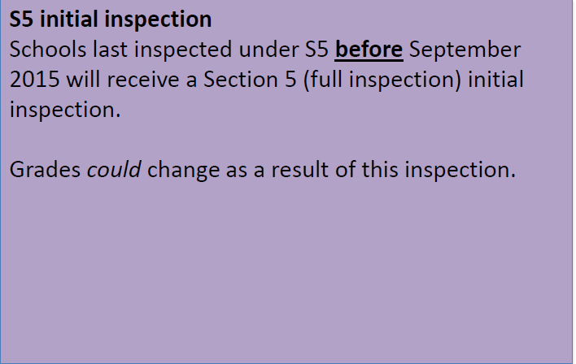
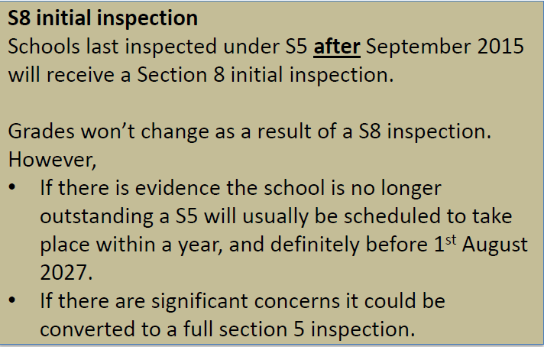
Outstanding schools - initial inspections
As set out before the pandemic, outstanding mainstream schools are no longer exempt from routine inspection.
All previously exempt schools will receive an initial inspection before 1st August 2026. The type of inspection they receive will be determined as follows:

