Slide 1
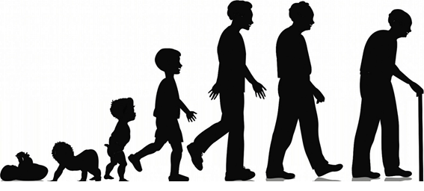
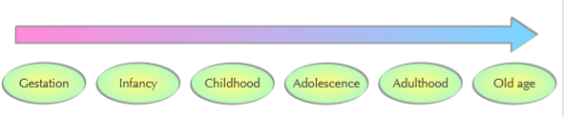
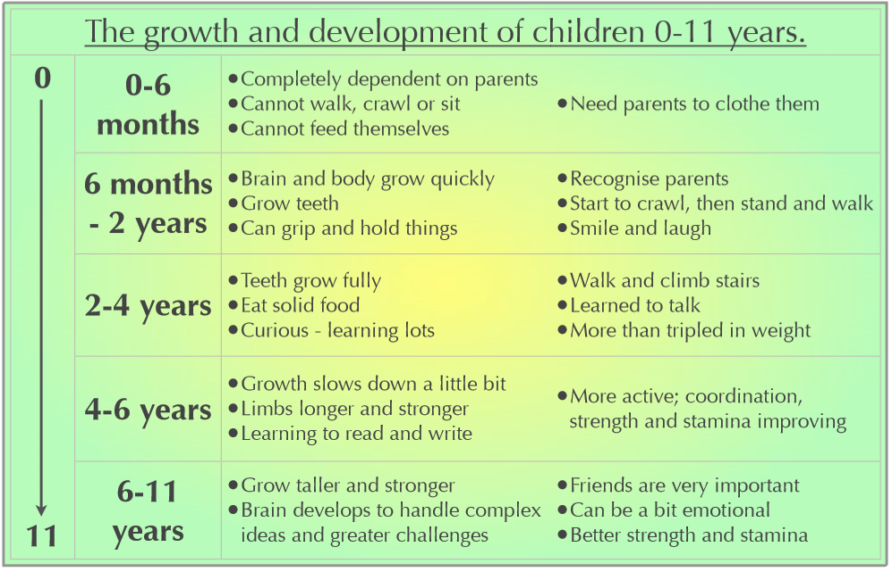
Year 5 Knowledge Mat: Growth and Development of Humans.
Subject Specific Vocabulary
Gestation | New life begins as a microscopic fertilized egg cell inside the mother’s womb. The cell divides and grows, getting bigger and bigger.
Infancy | Babies rely on their parents for everything at first. By the time they are four years old, toddlers have learned to walk, talk and read a few words.
Childhood | Between 4 and 9 growth slows down. Your bones and muscles continue to strengthen, your brain grows and develops.
Adolescence | Puberty occurs as this stage. Humans start to mature sexually. Girls’ and boys’ bodies start to develop and change.
Adulthood | You are fully grown. Your brain is fully developed and you are ready to produce and have children.
Old Age | As humans get older, their bodies are not as good at renewing and repairing themselves. Muscles, bones and eyesight gradually weakens and appearance changes.

