Slide 1
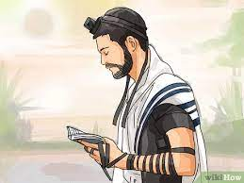
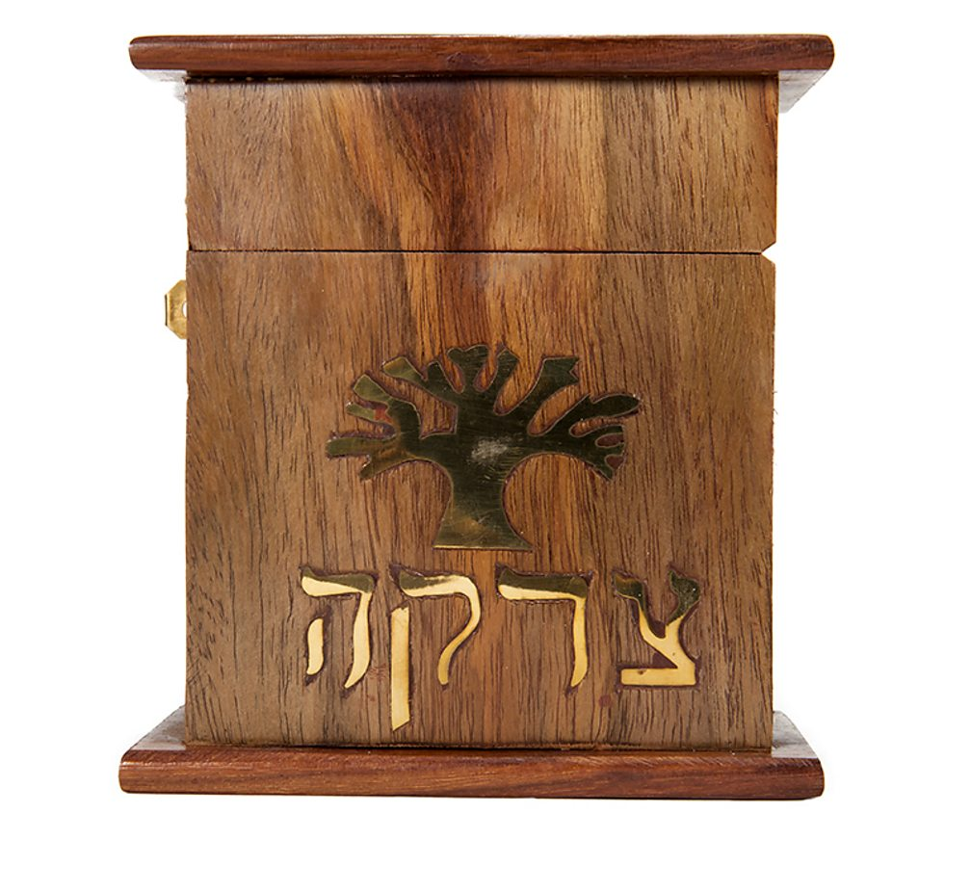
Year 5 Knowledge Mat: Judaism
Key Knowledge
During Shabbat, Jewish people remember the story of creation from the Torah where God created the world in 6 days and rested on the 7th day. Jewish men wear two visible symbols of prayer, the tallit and the tefillin (small capsules with handwritten scripture passages. One is strapped to the upper arm and the other to the forehead) In the Orthodox tradition, only men wear the tallit, tefillin and kippah, but in the Reform tradition women may wear them too. Giving tzedakah is one of the most important commandments for Jews. It is customary to donate money to charity before Shabbat and Jewish holidays.
Subject Specific Vocabulary
Judaism | Jewish religious belief is that there is one eternal God who is spirit and has no human form.
Star of David | Key symbol of Judaism represented by a six-pointed star.
Passover | Jewish festival celebrated in Spring time. It reminds people of their people’s escape from slavery over 3000 years ago.
Sabbath (Shabbat) | Jewish holy day from nightfall Friday to nightfall Saturday.
Orthodox Jew | A Jew who adheres faithfully to the principles and practices of traditional Judaism
Bar Mitzvah | The initiation ceremony of a Jewish boy who has reached the age of 13 and is regarded as ready to observe religious precepts and eligible to take part in public worship.
Bat Mitzvah | A religious initiation ceremony for a Jewish girl aged twelve years and one day, regarded as the age of religious maturity.
Tzedakah | Charitable giving, typically seen as a moral obligation.
Torah | Jewish Holy book. It contains the laws by which Jews try to live.
A Jewish man wearing a tallit, tefillin and kippah to pray.
A tzedakah box. Most Jewish people will keep one in their house and place money for charity in it.

