Slide 1
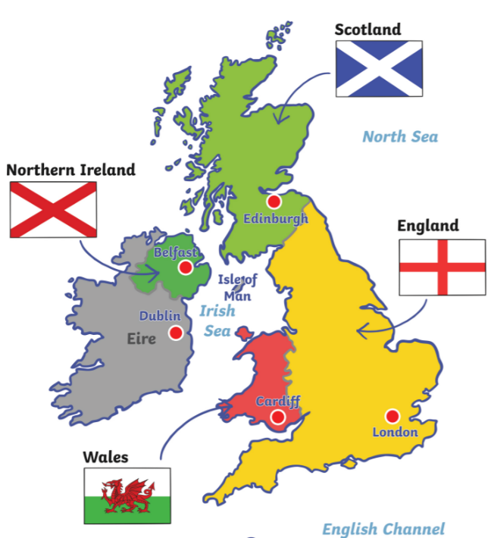

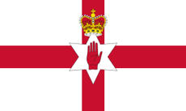


Year 2 Knowledge Mat: Where do I live?
Subject Specific Vocabulary
Capital City | The city where the government of the country is based.
Continent | One of the seven main areas of land that the world is divided into.
Country | A country that is controlled by a single government. Most countries are split into small parts.
Earth | The name of the planet we live on.
Ocean | The water around the world is divided into 5 oceans.
United Kingdom (UK) | The country that is made up of England, Northern Ireland, Scotland and Wales.
Key Knowledge
To know that the United Kingdom is part of the continent of Europe. To know that the United Kingdom is a country that is divided into 4 parts called England, Northern Ireland, Scotland and Wales. To be able to locate and label the countries of the United Kingdom To know that we live in England and that is part of the UK. To know that the United Kingdom is an island and is surrounded by water. To be able to locate the United Kingdom on a map. To know the names of the capital cities of the United Kingdom are Belfast, Cardiff, Edinburgh and London.
The United Kingdom
England
Northern Ireland
Scotland
Wales

