Slide 1
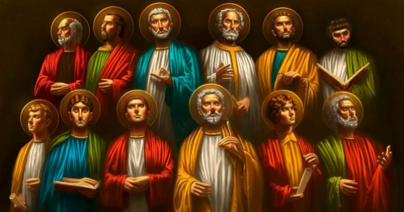
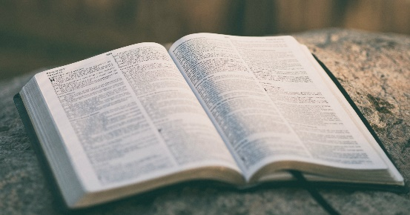
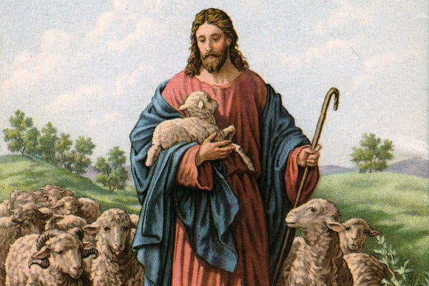
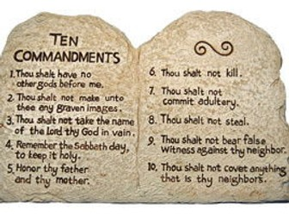
Knowledge Mat: Christian Scripture
God | The creator of the Earth and ruler of all people.
Jesus | The son of God who died to save peoples sins.
Bible | A very important book for Christians that tells the life of God, Jesus and the disciples.
Christian | A person who believes in Christianity.
belief | When someone is committed to following the rules of God.
prayer | When someone expresses thanks to God. A piece of text that is sang or read in prayers.
10 commandments | A list of rules from God that all Christians are expected to follow.
disciples | Jesus’ friends and later a dedicated follower of God.
miracle | Extraordinary event in the physical world that surpasses all known human power.
Key Knowledge
Christians believe Jesus was the son of God. Most of the disciples were farmers or fishermen before they followed Jesus. Andrew was the first disciple Jesus called.
Jesus’ 12 disciples
The Holy Bible
Jesus Christ
10 commandments

