Slide 1
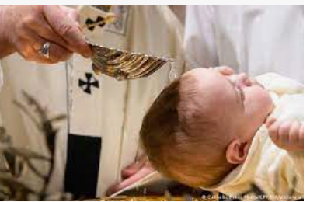
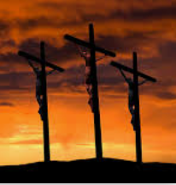
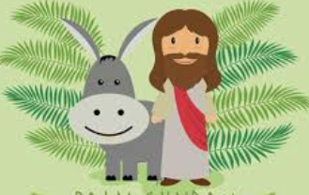
Year 2 Knowledge Mat: Celebrations
Subject Specific Vocabulary
God | The creator of the Earth and ruler of all people.
Jesus | The son of God who died to save people’s sins.
Bible | A very important book for Christians that tells the life of God, Jesus and the Disciples.
Christian | A person who believes in Christianity.
Christening | The ceremony where a person, often as a baby, is made a member of the Christian faith. Sometimes called Baptism
Palm Sunday | The day that Jesus rode into Jerusalem on a donkey and was welcomed by people waving palm leaves
Good Friday | The day that Christians remember that Jesus died on the cross to save them from their sins.
Easter Sunday | The day that Christians celebrate that Jesus rose from the dead and went to live in heaven with God.
Key Knowledge
To know that Christians go to church to celebrate important events. To know that being Christened is when a person becomes a Christian. To understand that Easter is the most important week in the Christian year. To know that Christian believe Jesus died on a cross on Good Friday. To know that Christian believe that on Easter Sunday Jesus rose from the dead.
Good Friday
Palm
Sunday
A Christening
Notes:
Animals
Understand that animals, including humans, have offspring which grow into adults
Describe the basic needs of animals, including humans, for survival (water, food and air)
Describe the importance for humans of exercise, eating the right amounts of different types of food, and hygiene
Explore and compare the differences between things that are living, dead, and things that have never been alive
Identify that most living things live in habitats to which they are suited and describe how different habitats provide for the basic needs of different kinds of animals and plants, and how they depend on each other
Identify and name a variety of plants and animals in their habitats, including micro-habitats
Describe how animals obtain their food from plants and other animals, using the idea of a simple food chain, and identify and name different sources of food.

