Slide 1
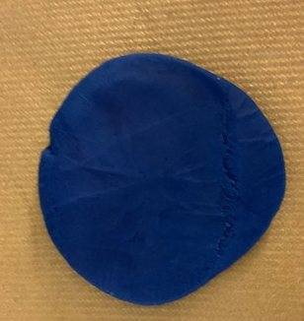
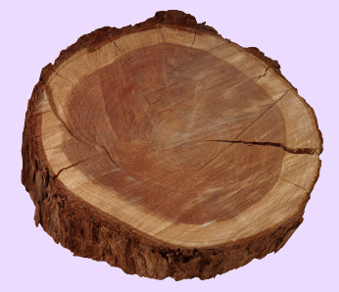
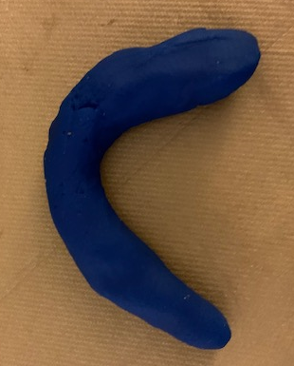

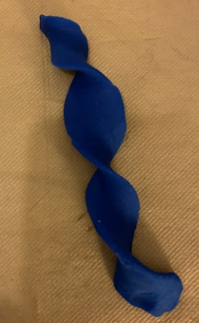
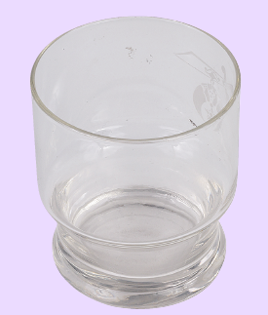
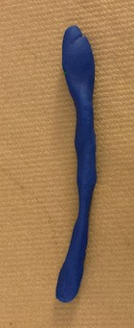

Year 2 Knowledge Mat: Everyday Materials
Subject Specific Vocabulary
Natural | Something that is found in nature and can be used by people. Earth's natural resources include light, air, water, plants, animals, soil and stone.
Man-made | Made by people rather than nature.
Metal | A substance that has a more or less shiny appearance, and usually can be made into a wire or hammered into a thin sheet.
Plastic | A material made by people that can be formed into any shape when heated at a very high temperature.
Material | A substance to use something.
Flexibility | Being able to bend and snap back without breaking.
Product | Something that results from being made.
Classify | To sort objects into different groups or categories.
Predict | A guess about something that might happen.
Wood
Squash
Metal
Bend
Leather
Glass
Twist
Wool
Stretch
Notes:
Animals
Understand that animals, including humans, have offspring which grow into adults
Describe the basic needs of animals, including humans, for survival (water, food and air)
Describe the importance for humans of exercise, eating the right amounts of different types of food, and hygiene
Explore and compare the differences between things that are living, dead, and things that have never been alive
Identify that most living things live in habitats to which they are suited and describe how different habitats provide for the basic needs of different kinds of animals and plants, and how they depend on each other
Identify and name a variety of plants and animals in their habitats, including micro-habitats
Describe how animals obtain their food from plants and other animals, using the idea of a simple food chain, and identify and name different sources of food.

