Slide 1
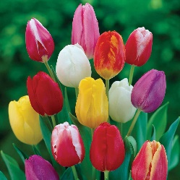
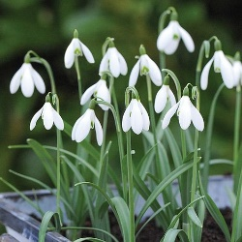
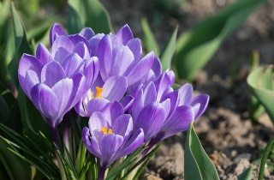
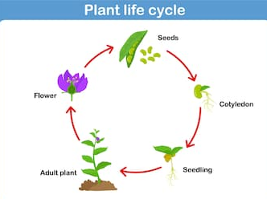
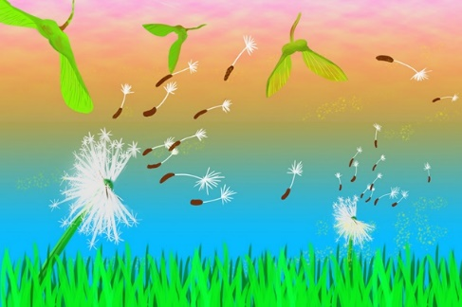
Year 2 Knowledge Mat: Plants
Subject Specific Vocabulary
Seed | Small parts of a plant that is made by a plant. The seed allows new plants to grow.
Bulb | Part of the plant that grows underground and stores food.
Roots | Roots anchor the plant to whatever material it is growing in or on.
Stem | The stem supports the leaves and allows the plants to get food.
Germination | A phase of plant growth that allows the seed, roots and shoots to grow. It takes approximately 2 weeks (14 days) for a seed to germinate.
Seed dispersal | The way seeds get from their parent plant to a new place. Dispersal means scatter or spread.
Variable | A quantity, object or item that can be changed.
Fair test | In a fair test, two or more objects are compared but only one variable can be changed.
Tulips
Snowdrops
Crocus
Seed dispersal by the wind
Homework: Due Friday 25th March
Go for a walk near your home. Can you make a Tally chart of the most common plants and flowers that you find. Now find out if they grow from bulbs or seeds and make a list of each?

