Slide 1
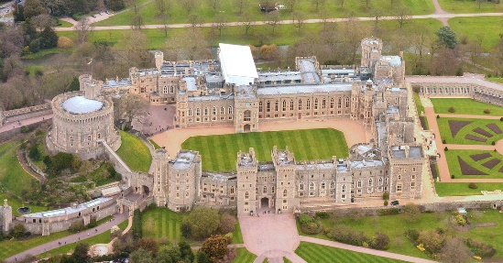
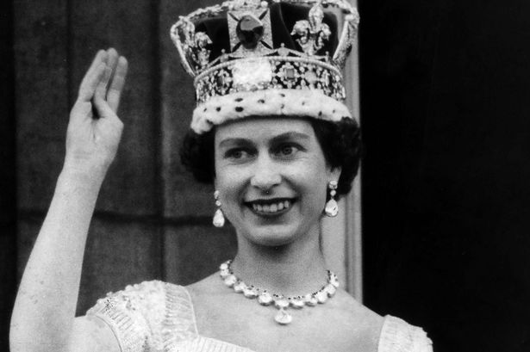
Year 2 Knowledge Mat: Castles
Subject Specific Vocabulary
castle | A structure built during the Middle Ages by the nobility or royalty.
Windsor | The British Royal Family since 1917 and a famous town in Britain.
The Royal Family | The immediate family of a reigning monarch.
moat | A perimeter ditch with or without water.
battlements | A protective, tooth shaped wall often with a walkway behind it
drawbridge | A bridge that could be pulled up, preventing access across moats.
arrow slits | Slits in walls that provided a safer means of firing arrows on the attackers of the castle.
knight | A man who served his country or lord as soldier in armour.
banquet | An elaborate and formal meal for many people.
Key Knowledge
To understand the importance of castles in History and their modes of defence. To know why a castle is needed. To know people lived and worked in castles. To know the Queen has many homes including Windsor. To know what she does in Windsor Castle. To know the Coat of Arms of Windsor Castle. Understand why people use a Coat of Arms. To know the types of food eaten at a Medieval banquet.
Windsor Castle
Queen Elizabeth II

