Slide 1
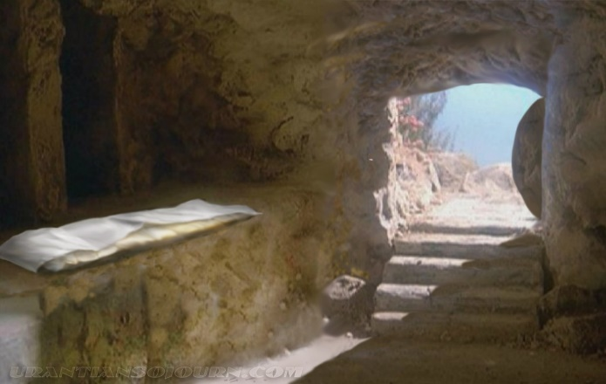
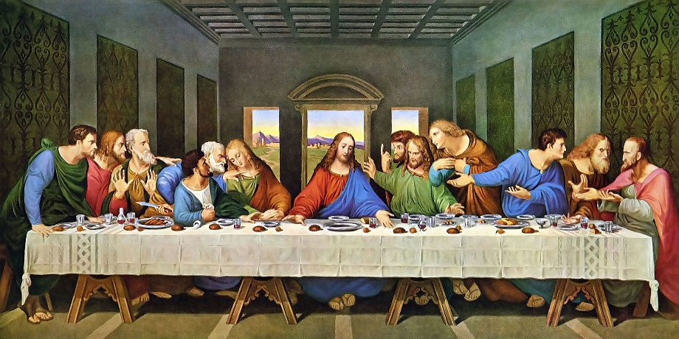
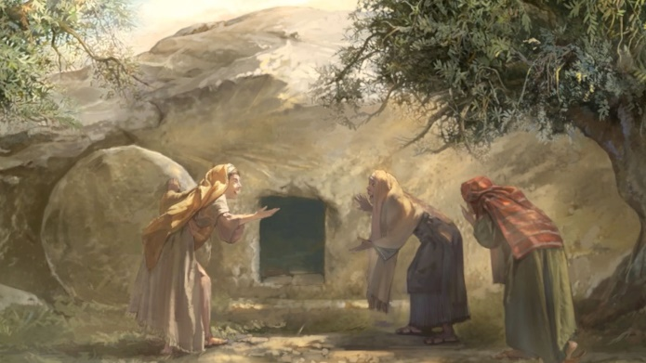
Year 6 Knowledge Mat: Christianity – resurrection
Subject Specific Vocabulary
Gospel | The Gospels give accounts of Jesus’ death and resurrection. They are found in the New Testament (Matthew, Mark, Luke and John).
Resurrection | The rising of Jesus from the dead.
Sin | Purposely disobeying the rules of God.
Disciples | Followers of Jesus.
Salvation | The saving of human beings from sin and its consequences, which include death and separation from God by Christ's death and resurrection.
Reconciliation | Forgiveness and to be at peace.
Christians believe Jesus willingly gave up his own life in order to take on the punishment for all sin, for all people. Because of sin, people need to be saved and Jesus brings salvation.
This belief gives Christians hope for life with God, starting now and continuing in a new life (heaven).
Many Christians say that a belief in the resurrection of Jesus, and therefore that death is not the end, leads to hope.
Jesus’ resurrection means that Christians have hope of a life after death.
The Gospels present a number of eye-witnesses to the resurrection.
Representation of the Last Supper

