Slide 1
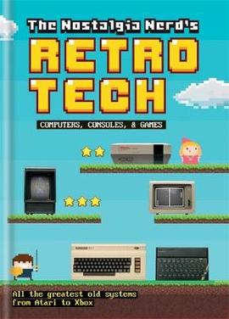
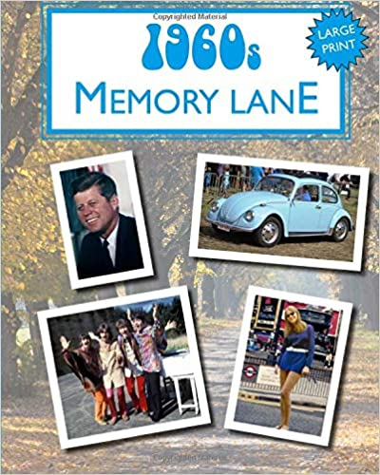
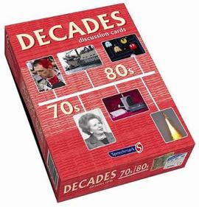
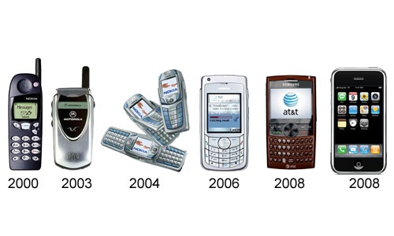
Year 6 Knowledge Mat How life has changed since 1945
Exciting Books
Subject Specific Vocabulary:
Primary source | Is a something that was written or created during the period that is being studied. It shows an inside look at what a person, event or period was like. Primary sources include: diaries, speeches (written or recorded), letters, interviews, ofﬁcial records, autobiographies, art, clothing, pottery and photographs.
Secondary source | Secondary sources interpret primary sources by looking at the evidence presented and drawing conclusions about what a person, event or period was like. The most common form of a secondary source is a textbook but other secondary sources include magazine articles and biographies.
Subject Specific Vocabulary:
Decade | A period of 10 years. 1950s, 1960s, 1970s, 1980s, 1990s,
Century | A period of 100 years. 1900s to 2000.
Millennium | A period of a 1000 years. 1001 to 2000.
Life through the decades
Working life
Population
Home life
Popular Culture
Technology
1945
60’s
80’s
00’s
2020
50’s
70’s
90’s
2010

