Slide 1
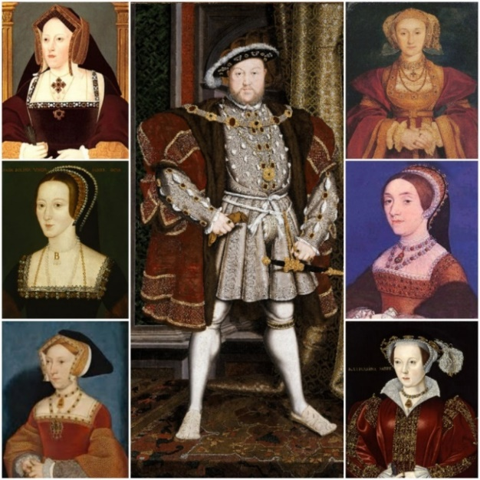
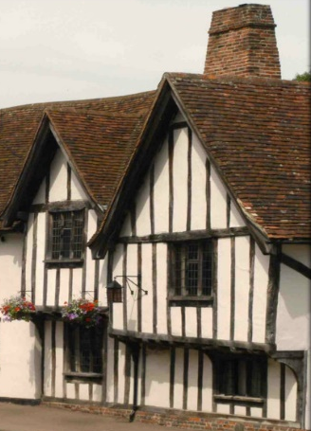
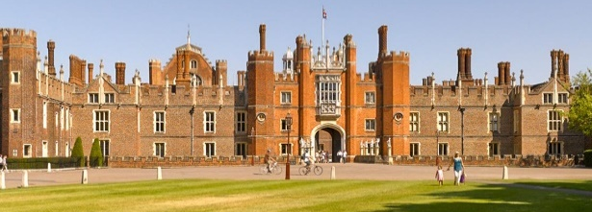
Year 4 Knowledge Mat: The Tudors
Tudor Kings and Queens
Henry VII | 1485 - 1509
Henry VIII | 1509 - 1547
Edward VI | 1547 - 1553
Jane Grey | 1553 - 1553
Mary I | 1553 - 1558
Elizabeth I | 1558 - 1603
The Tudor reign lasted from 1485 to 1603.
Subject Specific Vocabulary
Monarch | A King or Queen, the position of monarch was inherited by the eldest son or daughter of the previous monarch.
William Shakespeare | A famous writer and poet in the Tudor times, responsible for many still well known plays and the famous Globe theatre.
The Black Death | A plague that spread throughout England during the Tudor reign.
The War of The Roses (1485) | This War took place between the houses of York and Lancaster and The Tudor Rose is the symbol of it ending.
Church of England | Henry VIII broke away from the Catholic Church and set up the Protestant Church of England.
Spanish Armada | A fleet of ships that was put together to defend the New World from invasions by Sir Francis Drake, a Tudor sailor.
Optional Homework
Due – 16.05.25
Make a written fact file or Powerpoint to present to the class at the end of the term about the Tudor Reign.
Write a song about the Tudors, including facts that you have learnt.
Pretend you are a monarch from the Tudor reign and write a diary entry about your day as a King or Queen.
Tudor house
Hampton Court Palace – Henry VIII’s main residence

