Slide 1

Welcome to Year 6
Red Kites
Mrs Shay,
Mrs Gordon-Jones,
Mrs Newcomb and
Mrs Mitchell

Slide 2





Science
Living things
Electricity
Animals
Evolution
Light and Shadow
Geography
Population
Energy
DT
Come Dine with Me
Making bags
Steady hand game
History
World War II
Census
Sikh Empire
Art
Expressing ideas (drawing)
Artist study
Photo opportunity

Slide 3
The Curriculum
The national curriculum is just one element in the education of every child. There is time and space in the school day and in each week, term and year to range beyond the national curriculum specifications.
The national curriculum provides an outline of core knowledge around which teachers can develop exciting and stimulating lessons to promote the development of pupils’ knowledge, understanding and skills as part of the wider school curriculum.

Slide 4
Expectations for reading
Reading for pleasure and for purpose
Justifying answers with examples from the text
Understanding the author’s reasons for vocabulary, punctuation and structure choices.
Summarising from more than one paragraph.

Slide 5
Expectations for writing
Write at length across a range of text types (narrative, non-fiction, poetry)
Showing an understanding of audience and purpose
Make deliberate choices and decisions about vocabulary, and sentence lengths, types and structures
Use dialogue to convey character & advance action
Write with increasing legibility, consistency and fluency, including joining letters

Slide 6
Expectations for maths
Compare and order numbers up to 10,000,000.
Use negative numbers, factors and multiples
Round any number including decimals
Use BODMAS
Add and subtract 7-digit numbers and numbers to 3 decimal places using the formal column method
Multiply any 4-digit number by a 2-digit number
Divide: any 4-digit number by a 2-digit number (long division)
Loads of types of fractions
Finding percentages
Simple algebra e.g. 2a + 1 = 5 so a = 2
Data handling, 3D & 2D shapes, and angles

Slide 7
Assessment
When we are assessing each child’s progress we measure them against age-related expectations.
We measure the progress across the year. At the start of Year 6 most children will be Year 6 Emerging.
By the end of Year 6, the expectation is that most children will be Year 6 secure.
Throughout the year the children will progress through emerging, developing and secure.
If your child is working below age related expectations they may receive additional support, which will be discussed between parents and teachers.

Slide 8




Performance
Residential
Bonus activities for Year 6
Transition activities
Bikeability

Slide 9



English modules
These are some of the books we will be using for our English sessions.
There are lots of different types of books we will be using to inspire our writing!

Slide 10




Guided Reading books
Goodnight Mister Tom
Michelle Magorian
Kensuke’s Kingdom
Michael Morporgo
Wonder
R. J. Palacio
The Explorer
Katherine Rundell

Slide 11
Your Child’s Day
8:45 – 9:00 Morning activity
9:00 – 9:15 Spelling/assembly
9:15 – 10:30 English and grammar
10:30 – 10:45 Break
10:45 – 11:45 Maths
11:45 – 12:30 Guided reading
12:30 – 1:25 Lunch
1:25 – 1:50 Arithmetic
1:5o – 3:00 Foundation Learning
3:15: Home time

Slide 12
Homework
Spelling test every Friday
Grammar Homework
Reading Homework
Online MyMaths Homework
Marked in school the following Friday

Slide 13
SATs!
Monday 10th May Grammar Paper 1 and 2
Tuesday 11th May Reading
Wednesday 12th May Arithmetic and reasoning 1
Thursday 13th May reasoning 2

Slide 14
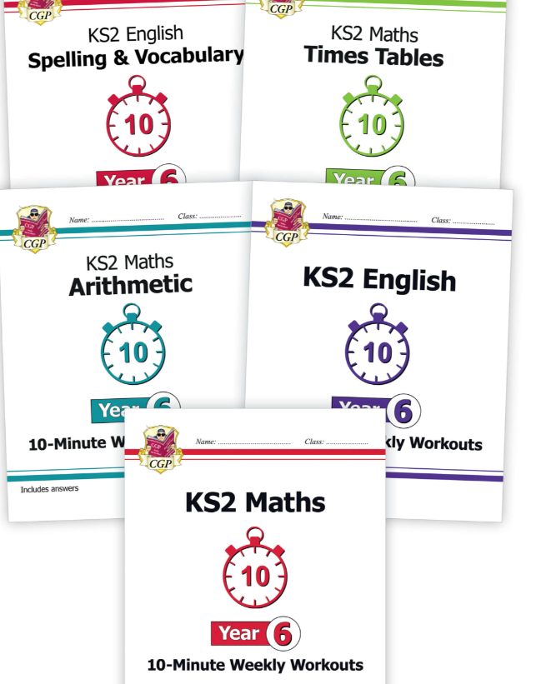
CGP books

Slide 15

Any questions?

