Slide 1
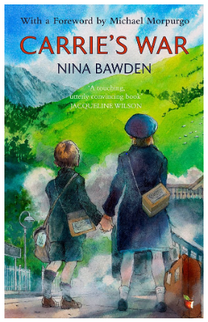


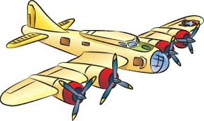

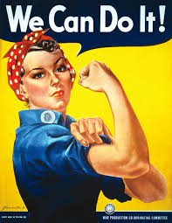
Year 6 Knowledge Mat: World War Two
Subject Specific Vocabulary
Treaty | Written agreement between two countries in which they agree to do a particular thing or to help each other.
Invasion | When a foreign army enters a country by force.
Holocaust | The killing of millions of Jews by the Nazis.
Rationing | A system during World War Two to limit the amount of food you were allowed to buy.
Blitz | Attacked by bombs dropped by enemy aircraft.
Evacuate | To send someone to a place of safety, away from a dangerous building, town or area.
Propaganda | Information that is not objective and is used primarily to influence an audience.
Conflict | A serious disagreement and argument about something important.
Fatality | A death caused by an a accident or by violence.
Seize | Taking control of a place quickly and suddenly, using force.
Timeline
1918 | The Treaty of Versailles – Ended WW1.
1933 | The Nazi Party led by Adolf Hitler came to power in Germany.
1936 | German troops invaded Austria.
1938 | German troops invaded Czechoslovakia.
1939 (1st September) | German troops invaded Poland.
1939(3rd September) | Britain declared war on Germany. World War Two Started.
1940 (July – October) | The Battle of Britain – German air force bombed large cities in Britain.
1940 (September) | The Blitz Attack – German bombers attack Britain at night.
1945 (8th May) | VE Day – Victory Day in Europe, WW2 declared over.
Exciting Books
Key Knowledge
WW2 Started in 1939 and lasted till 1945. The main counties involved in WW2, were the Allies (Great Britain, USA, Russia and France) and the Axis (Germany, Japan and Italy). The government issued gas masks to everyone in Britain. German submarines were attacking British ships creating a shortage of supplies. This led to rationing. Propaganda posters were used to encourage citizens to act safely and support the war effort. Air raids were built in gardens called Anderson Shelters. Shelters under stairs or in a house were called Morrison Shelters. Many children were evacuated from cities to the countryside. Women worked in factories, on farms and in the air force.

