Slide 1

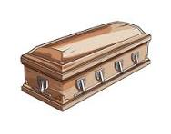

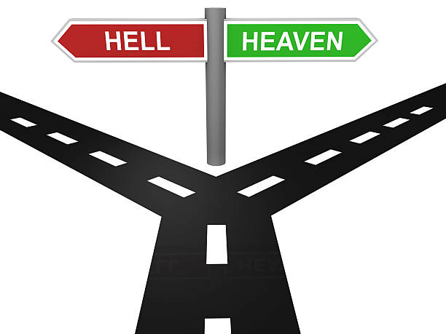
Year 6 Knowledge Mat: Life after death
Funeral: A special ceremony that takes place after someone dies, where family and friends come together to remember their life and say goodbye.
Types of Christians
Catholic Protestant Orthodox
gravestone
coffin
hymns
Resurrection | when someone comes back to life after dying, like Jesus did.
Heaven | a happy place where Christians believe people go to be with God after death.
Hell | a place away from God where people are not happy.
Miracle | something amazing that cannot be explained by normal rules, often seen as a sign from God.
Eternal life | living forever with God after death.

