Slide 1
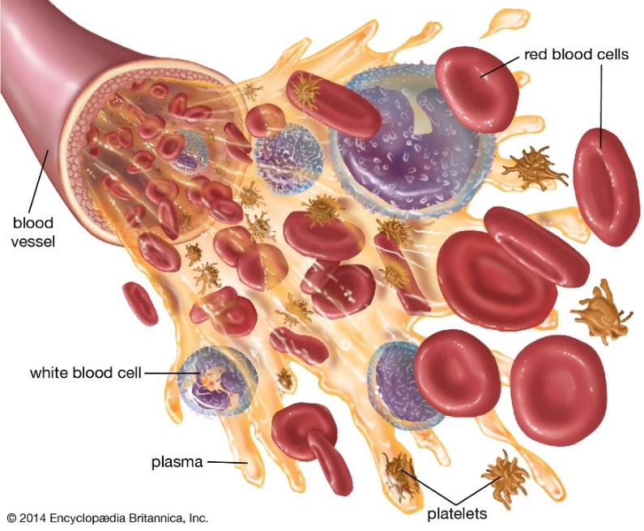
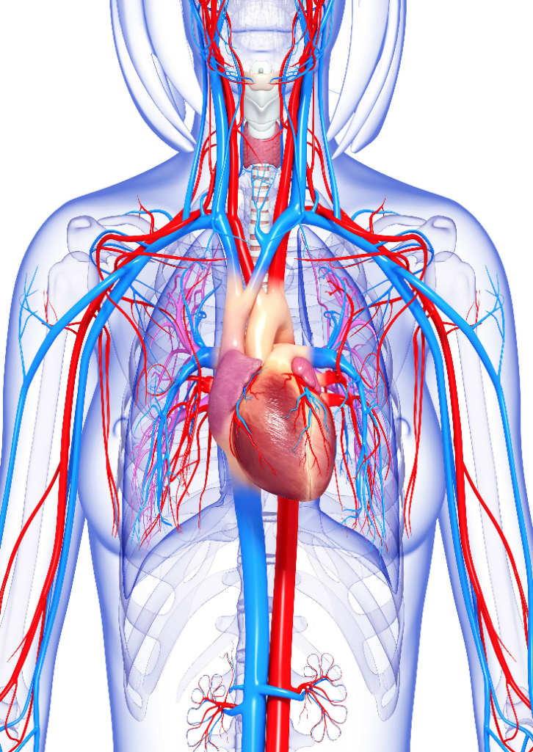
Year 6 Knowledge Mat: Healthy Bodies
Subject Specific Vocabulary
Carbohydrates | A source of energy. Carbohydrates are mainly sugars and starches that the body breaks down into glucose.
Fats | The body uses fats to store energy, to maintain its temperature, and to cushion organs. Fats also help the body use certain vitamins.
Proteins | Protein builds, maintains, and replaces the tissues in your muscles, organs, and immune system.
Circulatory System | A system of the body that circulates blood and includes the heart and blood vessels.
Pulmonary System | A system of the body used in breathing and includes the nose, throat and lungs.
Artery | Tubes that mostly carry oxygen full blood from the heart to all parts of the body.
Vein | Tubes that carry blood to the heart. Most veins carry blood that is low in oxygen
Circulatory System
Plasma | Yellowish liquid portion of the blood that contains electrolytes, nutrients and vitamins and hormones
White Blood Cells | They are part of the immune system White blood cells protect the body from infections.
Red Blood Cells | Red blood cells carry oxygen from your lungs to your heart, and then to your muscles.
Platelets | These help the blood to clot if you get a cut.

Slide 2
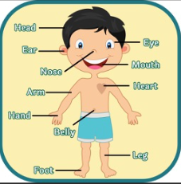
Year 6 Vocabulary Mat:
arms | eyes | shoulders | legs | head
knees | toes | ears | mouth | nose

