Slide 1
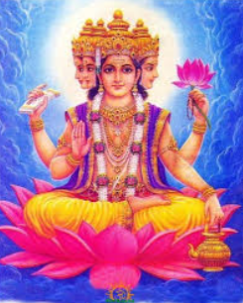
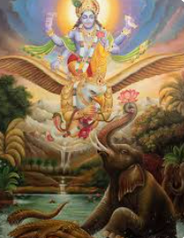
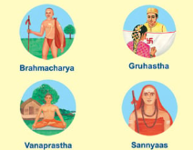
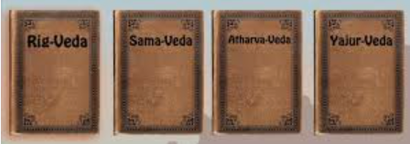
Year 6 Knowledge Mat:
Key question: What do Hindus learn about God and human life from their sacred texts?
Subject Specific Vocabulary
Brahman | Eternal, unchanging universal spirit
Vedas, the Upanishads, Mahabharata, Ramayana and the Puranas | Different sacred texts, containing various stories that guide Hindus in how to live their lives.
Ashramas | The four stages of Hindu life
Brahmacharya | The first stage of life, learning and studying
Grihastha | The second stage, being a householder and parent
Vanaprastha | The third stage, retirement and reflection
Sannyasa | The fourth stage; pursuing a spiritual life with no belongings or family. A person living in the fourth ashrama is called a sannyasin.
Karma | The consequences of how well you live your life and what happens to you in your next life.
Moksha | When you have lived your life the best way you possibly can and are freed from earthly bodies

