Slide 1
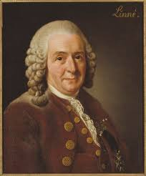
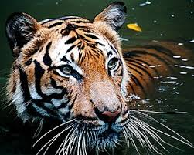
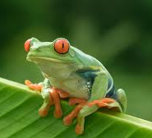
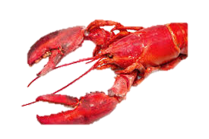
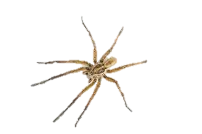
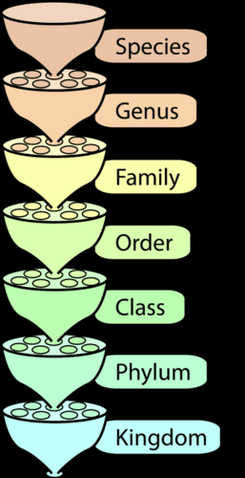
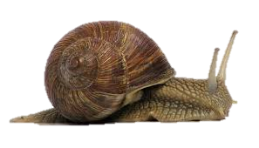
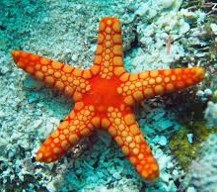
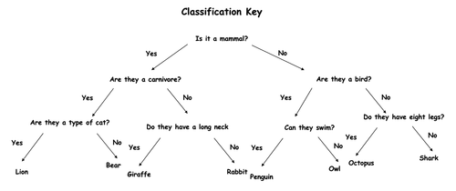
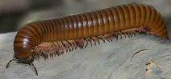
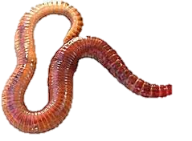
Year 6 Knowledge Mat: Classifying Organisms
Subject Specific Vocabulary: Plants
Botanists | An expert of the scientific study of plants.
Vascular | Plants that have a system for transporting water and nutrients to different parts of the plant.
Non-vascular | Plants which do not have roots or a stem. Instead they have tiny hairs called rhizoids.
Subject Specific Vocabulary: Animals
Mammal | A warm blooded vertebrate animal that has hair or fur.
Amphibian | A cold blooded vertebrate animal.
Crustacean | Invertebrates with an exoskeleton, many legs and antennae.
Arachnid | Invertebrates with eight jointed legs. In some, the front set of legs are sensory.
Mollusc | Invertebrate with soft, unsegmented bodies. Many have a hard outer shell.
Echinoderm | Invertebrates with spiny skin, such as a starfish or sea urchin.
Myriapod | Invertebrate with many legs and body segments, such as a centipede.
Annelid | Invertebrate with no legs and a segmented body, such as an earthworm.
Carl Linnaeus
Subject Specific Vocabulary Animals
Vertebrates | Are animals that have a backbone.
Invertebrates | Are animals that do not have a backbone. This group includes animals with exoskeleton, like beetles.
Organism | An individual animal, plant or single cell life form.
Micro-organism | A microscopic organism, especially a bacterium, virus or fungus.
Classification

