Slide 1
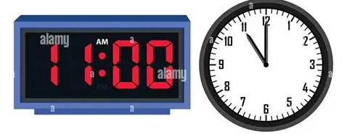
Year 4 Knowledge Mat: Time
Subject Specific Vocabulary
analogue clock | A clock with hands
digital clock | A clock showing numbers
12-hour clock | Time using am and pm
24-hour clock | Time written from 00:00 to 23:59
am | Time after midnight and before noon
pm | Time after noon and before midnight
midnight | 12:00 at night – 00:00
noon | 12:00 in the daytime; 12:00 pm
year | Twelve months
leap year | A year with 366 days
Conversion Facts
60 seconds = 1 minute 60 minutes = 1 hour 24 hours = 1 day 7 days = 1 week About 4 weeks = 1 month 12 months = 1 year 365 days = 1 year 366 days = 1 leap year For pm times after 12 noon, add 12 to the hour. 3:45 pm → 15:45 Morning times stay the same. 8:10 am → 08:10
Optional homework
Design a Theme Park Day Plan a day at a pretend theme park. You could: • schedule rides • use 24-hour time • calculate waiting times • work out total time spent 2. Stopwatch Challenge Children time activities to the nearest minute: • brushing teeth • tidying toys • running outside • reading Clock Hunt Children look around the house for clocks: oven microwave phone watch car clock Write the time shown Convert each to 24-hour time Find the clock closest to the exact minute Due date 10th July 2026

