Slide 1


What are you most WORRIED about when your child is ONLINE?

Slide 2

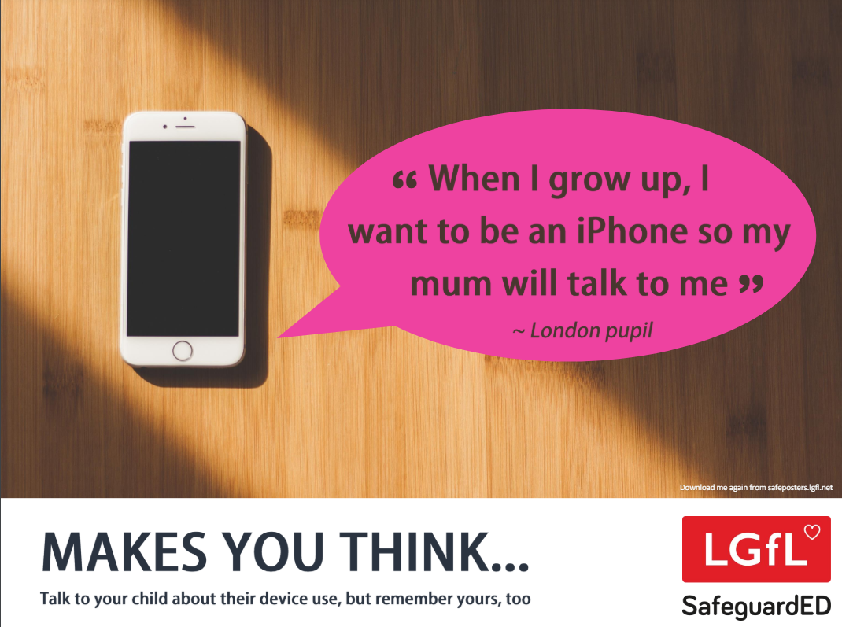
How does your child feel about YOUR SCREENTIME vs THEIRS?
45% of 8-11s feel that their parents’ screentime is too high
35% of 8-17s feel that their own screentime is too high
Source: Children and parents: media use and attitudes report 2024
Notes:
)

Slide 3


How do you keep up with online safety?

Slide 4



YOU don’t need to be an EXPERT … be a PARENT
It’s your choice - Don’t let others dictate when the right time is to use tech.
Stay involved – make time to communicate, talk about what they are doing. What do they enjoy? What makes them laugh?
Don’t quiz them – have regular conversations. What's their favourite app? What is the best site to learn new things from?
Join in - watch them play a game and join in. Who are they playing with? Do they know the other players?
‘Show me how…’ – ask their advice to help you with your privacy settings, who you should add as a friend, are there any risks?
Lead by example - children learn as much from watching as they do from being told not to do something, so model good behaviour
Reassure them - tell them that they won't get in trouble and that you are always there to help.

Slide 5

The positives of being online…
59%
3/4
of children say the internet has a positive impact on their wellbeing*
% of children who say spending time online makes them feel confident**
of children say the internet/tech is important for their independence**
*Internet Matters tracker survey, Wave 19 (2024)
**Children’s Wellbeing in a Digital World, Year Three, Internet Matters (2024)

Slide 6

What they’re doing online…
70%
46%
36%
Source: Internet Matters tracker survey, Wave 19 (2024)

Slide 7


The potentially negative impacts…
Sleep cycles are often affected by blue light from too much screen use, which can impact their daytime activities like school;
Excessive screen use might result in less movement, leading to physical health issues
Platforms use persuasive design to keep people using it, which children are particularly vulnerable to
More time online means more opportunity to come across potential harms.

Slide 8
Device preferences by age
Source: Internet Matters tracker survey, Wave 19 (2024)

Slide 9


Smartphones vs dumb phones
Internet access
Apps and games
Connection any time
A range of parental controls
No internet access
No (or few) apps and games
Messages and calls any time
Limited parental controls

Slide 10
What RULES do YOU SET about being online?
Spending money online (52%)
Who you can interact with online
Information their child can share online (49%)
While parental concerns in some areas have increased considerably, their enforcement of rules appears to be diminishing, partly because of resignation about their ability to intervene in their children’s online lives.
Where and when devices can / can’t be used
Types of websites and apps they can use (41%)
Video content their children are allowed to watch online (67%)
Source: Children and parents: media use and attitudes report 2024

Slide 11
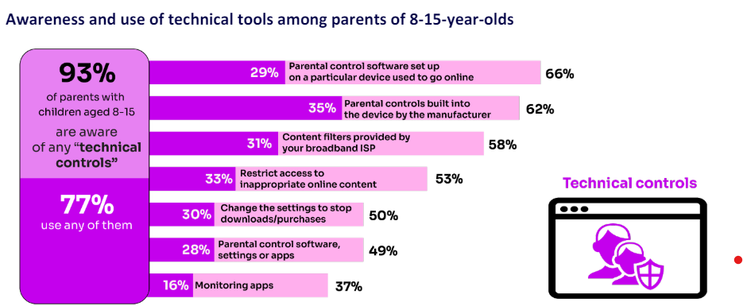
High awareness of technical control tools among parents, BUT many are choosing not to use them
WHY DO YOU THINK THIS IS THE CASE?
Around four in ten parents who know about content filters prefer to rely on their child’s ability to navigate online content rather than to have a technical filter
‘I prefer to supervise my child’s online use by talking to them about setting rules’
(39%)
Source: Children and parents: media use and attitudes report 2024

Slide 12



Common online safety issues

Slide 13
Types of harmful risks
Contact | Content | Conduct | Commerce
Contact risks come with online communication. This could include cyberbullying and hate speech as well as grooming and sextortion. | Content risks come with image- and video-sharing online. It’s also in video games and music. This could include explicit or hateful language, violent videos, age-inappropriate games and pornography. | Conduct risks are the actions children might take that could lead to harm. This could include visiting porn sites, gambling platforms and chat rooms, or sending sexual images or texts. | Commerce risks come with online spending, advertising and scams. This could include clicking on ads in a mobile game, sending money to a harmful source or even receiving a phishing email.

Slide 14
Dealing with inappropriate CONTACT
What to talk about
Top tips & tools
Sometimes people hide behind fake profiles for dishonest reasons
Agree how they will respond to requests from people asking them for something/to do something
Never agree to meet up with anyone they don’t know in real life (or who makes them uncomfortable)
Set up safe social media profiles that don’t share personal information
Customise communication options in video games
Turn off geolocation settings on devices
Learn/teach your child how to report, block, mute and use any other similar tools

Slide 15
Dealing with inappropriate CONTENT
What to talk about
Top tips & tools
They can come to you if they see anything that upsets them
The importance of respect for each other and the meaning of consent
If they have seen online pornography, talk about the unrealistic image of sex and relationships it presents
Parental controls on home broadband
Content locks on mobile networks
Safe search on browser search engines (or use child-friendly search engines)
Content controls in the apps they use or games they play

Slide 16
Dealing with inappropriate CONDUCT
What to talk about
Top tips & tools
Talk to a trusted adult if they experience anything upsetting online or if they’re not sure about something
Think carefully about sharing images or videos of others without permission
Every action they take creates a digital footprint, which creates a picture of who they are; so, be responsible.
Demonstrate healthy behaviour both offline and online
Block age-inappropriate websites on broadband or using parental controls apps
Report inappropriate posts or content on social media or other apps to web providers or the Internet Watch Foundation.

Slide 17
Dealing with inappropriate COMMERCE
What to talk about
Top tips & tools
Talk about scams, including what they could look like and the harm they could lead to
Encourage them to come to you or another trusted adult if they’re not sure if something is trustworthy
Avoid clicking on unknown links or responding to unexpected emails/text/WhatsApp messages
Stay informed about scams that your child could come across in social media or video games
Install cyber security software on your child’s devices – there are free and paid-for options available
Where relevant, set up parental controls that restrict spending or require a PIN so you can check purchases first.

Slide 18
Risk is not harm
While risk-taking can lead to harm, it more often results in children discovering new passions and abilities.
Positive actions can limit risks from becoming harmful. Here are 5 tips:
Understand the risks
Communicate regularly
Keep risks in proportion
Agree on helpful mediation strategies
Develop coping strategies to foster resilience

Slide 19
Children who have experienced online issues
Source: Internet Matters tracker survey, Wave 19 (2024)

Slide 20
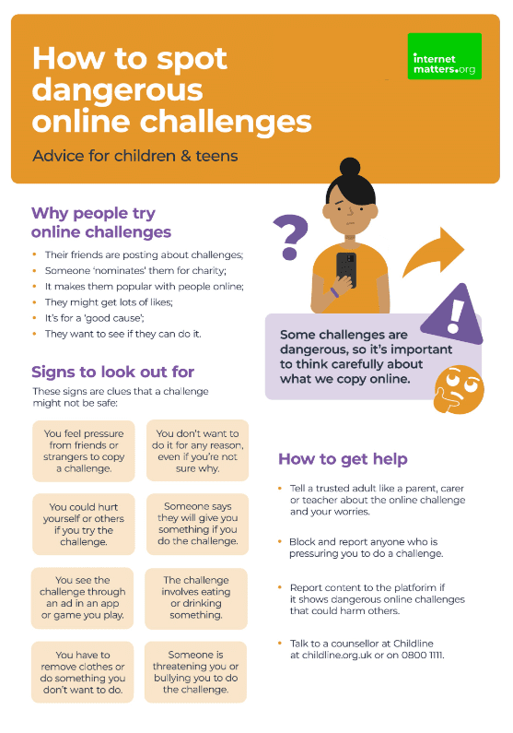
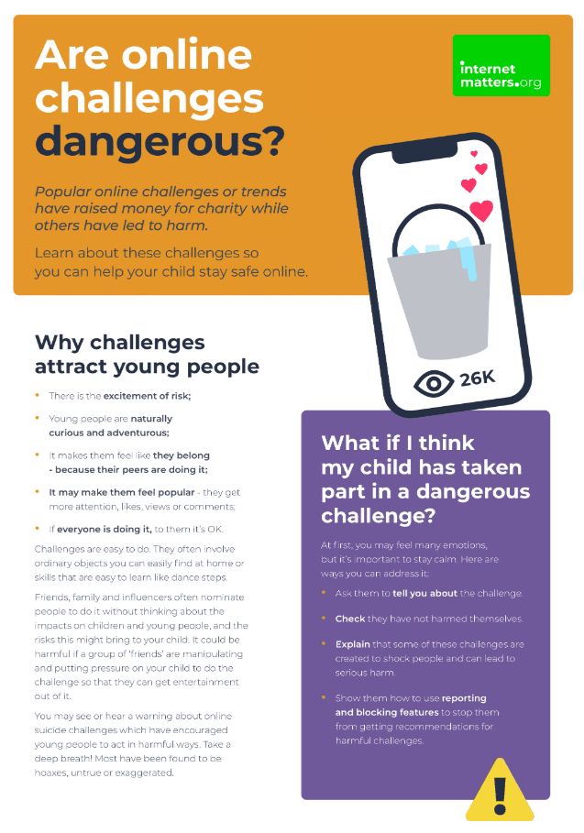

Dangerous online challenges
Viral online trends attract many children and teens
Most are harmless, but some can be dangerous
1 in 5 children say they’ve come across content which promotes dangerous stunts or challenges
It’s important to talk with your child so they understand the dangers and can avoid potential harm.
Notes:
.

Slide 21



Online bullying (cyberbullying)
Online bullying is more difficult to escape than ‘traditional’ bullying
It can happen between friends or strangers
It can happen in video games, on social media, in messaging apps, etc.
About 1 in 10 children say they have experienced online bullying. This increases for children with SEN needs or similar vulnerabilities.
Set parental controls, talk about healthy behaviour and show your child how to block and report content.
Cyberbullying conversation guide

Slide 22

Inappropriate content
27% of children see pornography by age 11
Around 1 in 10 children report seeing pornographic or violent content online. This increases with age.
Children with vulnerabilities are more likely to come across these things – especially violent content.
Parental controls can help limit access to certain websites, content and more. It’s also important for your child to report any inappropriate content they accidentally come across.

Slide 23

Spending too much time online
41% of children believe they spend too much time online
Of these children, most reported it causing them some distress, upset or harm
Not all screen time is negative, but if your child’s wellbeing is negatively impacted, they need your support.
Most games and apps have screen time controls to manage this, but you should also help them find other activities to make their time online positive.
Guide to
balancing screen time

Slide 24
3 things to teach your child
Be a confident communicator
Be a critical thinker
Be a capable tools user

Slide 25




Create your family’s digital toolkit
Get resources based on your child’s age, devices, interests and needs along with your concerns.
Learn about the popular apps and platforms your child uses and see how to set parental controls.
Learn how to deal with any issues or harmful risks your child might face.
Create your digital toolkit
Notes:
Scan the QR code or search ‘digital toolkit’ at internetmatters.org to create yours.

Slide 26
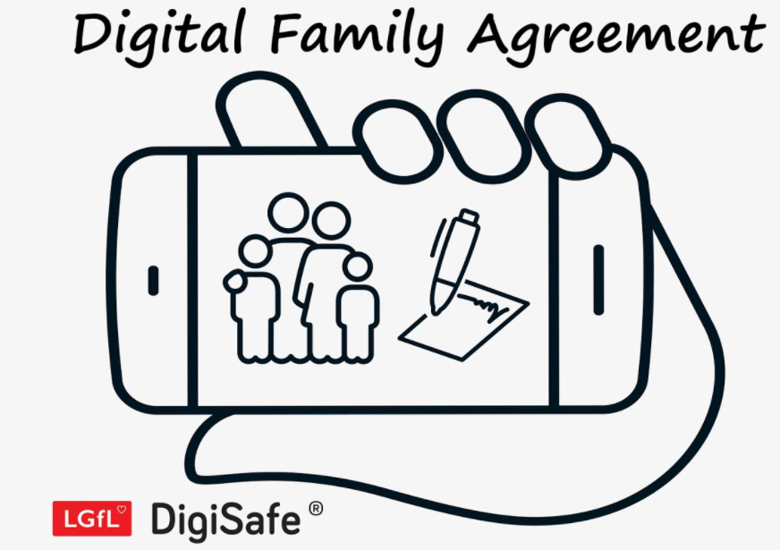
Why not have a family agreement to:
clarify what is allowed...or not
establish ground rules like no phones at the table or in the bedroom at night-time
agree shared expectations to reduce arguments and keep everyone safe & healthy
Download it at parentsafe.lgfl.net/digital-family-agreement
Notes:
.

Slide 27
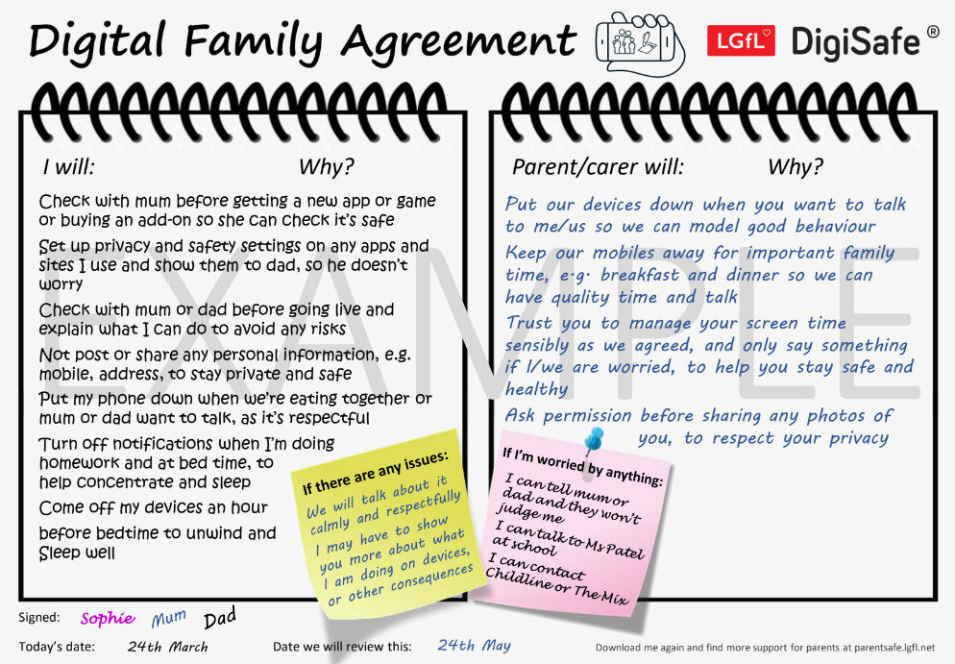
SHARENTING!
parentsafe.lgfl.net
Notes:
TELL - This is an example of a completed agreement – you may wish to take them through the sample statements to help them get started.
ASK – Have they heard of the term ‘Sharenting’?

Slide 28

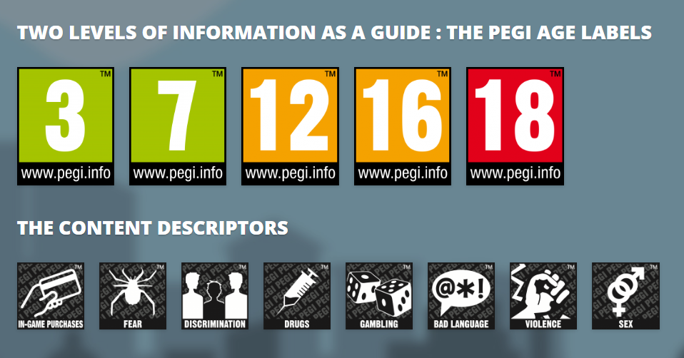
PEGI helps parents to make informed decisions when buying video games:
The age rating confirms that the game content is appropriate for players of certain age
It considers the age suitability of a game, not the level of difficulty
pegi.info
Notes:
.

Slide 29




UK Reporting Helplines and Services for Children and Young People
NCA
Young people can report concerns about child sexual abuse and exploitation to NCA
Report Remove
A free tool that allows children to report nude or sexual images and videos of themselves that they think might have been shared online
ChildLine
A free, private and confidential service where CYP can talk about anything to a trained counsellor, online or on the phone
Call 101 or 999 if there is an immediate risk of harm to your child
Go to reporting.lgfl.net to find out more

Slide 30




More support available at InternetMatters.org
Or on social media:
        /InternetMatters
        @IM_Org
        @InternetMattersOrg
        @InternetMatters

